Slide 1
First 5: An Alliance for CA’s Kids

Slide 2
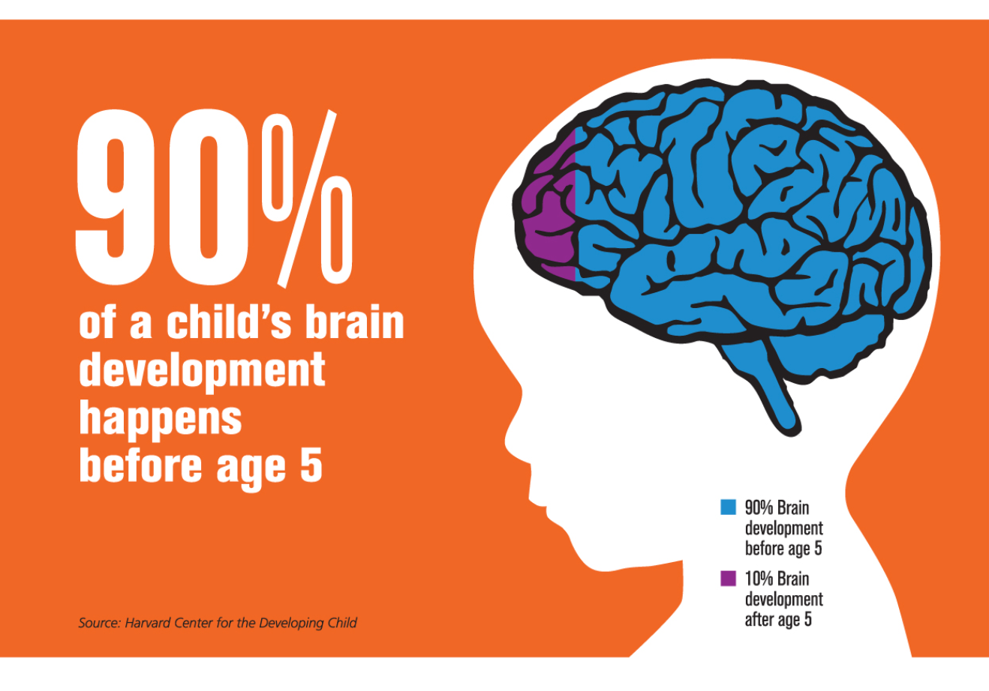
Why is First 5 Important?
“Early experiences affect how the brain develops, shaping how children learn, behave, and grow.”
- The Center for the Developing Child at Harvard University

Slide 3
What Happens in the First 5 Years Affects Us All
Supporting the early years can change the trajectory of a lifetime – and a society
WHAT HAPPENS AS A CHILD…
…SHAPES THE ADULT…
...AND THE REST OF SOCIETY
Positive parenting that fosters social and emotional resilience
Improved ability to relate to others in school, work, and at home
Safe and thriving communities; reduced social welfare costs
RESILIENT FAMILIES
COMPREHENSIVE HEALTH AND DEVELOPMENT
Access to well-coordinated medical care
Healthy habits, healthier lives
Healthier population, savings on social and medical costs
QUALITY EARLY LEARNING
Participation in high-quality preschool
Increased likelihood of high school graduation
More skilled workforce

Slide 4
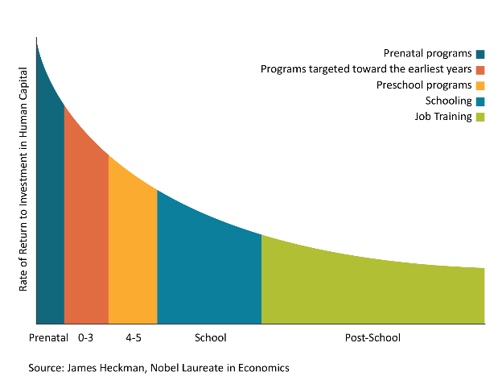
Public Money Goes Furthest When We Invest in Our Youngest Kids
High-quality birth-to-five programs for disadvantaged children can deliver a 13% return on investment

Slide 5
CA isn’t Spending Enough on Little Kids
Dollars allocated to early childhood through First 5 are marginal compared to other investments
CA Spending per Individual
$71,000
$ spent per individual
$10,050
$10,291
$9392
$160
First 5
Head Start
State Preschool
K-12
State Prison

Slide 6
Other Countries Invest in Families, The US Lags
And the US lags behind its global peers in spending on young families
Source: OECD (Organization for Economic Co-operation and Development) 2013

Slide 7
Inequalities Exist Across the State
The magnitude of need in CA is enormous. In every community there are those who are born facing greater challenges
47% of CA’s children live in or near poverty
Life expectancy varies dramatically from one neighborhood to the next:
In the Bay Area, life expectancies across ZIP codes vary by as much as 13 years
The life expectancy in West Oakland is 67, similar to countries such as Turkmenistan, Kazakhstan, and North Korea
In West Fresno, life expectancy is >20 years lower than in other parts of the city
In Los Angeles, there’s a 12-year gap in life expectancy across neighborhoods
Source: Public Policy Institute of CA; http://www.vitalsigns.mtc.ca.gov/life-expectancy

Slide 8
Families Struggle to Navigate Siloed Systems
The funding that does go to early childhood development is managed by many sources. Between formal and informal supports, there’s no “one-stop shop” for families.
Mental Health
Resource Centers
K-12
Home Visitors
Medical System
Childcare
Libraries
Child Welfare
Informal Supports
Parent Groups
Parks and Playgrounds
Notes:
Olson, Steve. The Committee on From Neurons to Neighborhoods Anniversary Workshop. From Neurons to Neighborhoods: An Update. Institute of Medicine and National Research Council of the National Academies. 2012.
Additional sources from Monterey’s plan: Bornfreund, 2015. And: Bachman, Sara S. The Care Coordination Conundrum and Children and Youth with Special Health Care Needs. Catalyst Center: Health & Disability Working Group, Boston University School of Public Health. November 2015. And: Henry, Holly et al. Teaching Families to Fish: How to Support Families as Care Coordinators. LPFCH. July 2013

Slide 9
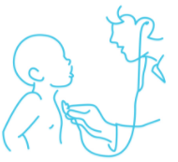
We Are Not Meeting the Needs of CA’s Children
Those that benefit the most from early childhood supports are not getting what they need
RESILIENT FAMILIES
1 in 7 children reported for abuse or neglect before age 5
1 in 4 young children in CA experience housing instability
COMPREHENSIVE HEALTH AND DEVELOPMENT
As many as 10K children are missing out on cost-saving early intervention each year
CA kids have high rates of untreated dental decay
QUALITY EARLY LEARNING
Only 45% of 3rd graders read at grade level
Child care costs are too high for most families

Slide 10
Summing Up the Problem We Face
Funding is not prioritized for 0-5
Parents and children have insufficient access to the community-based support they need
Children suffer in their development (health, learning, wellbeing)
Society suffers socially and economically
Parents struggle to navigate siloed systems
Poverty and inequalities persist

Slide 11
First 5 Vision Statement
One day, California’s success will be measured by the wellbeing of its youngest children

Slide 12
First 5 Supports Community Efforts
SIGNIFICANT FUNDER:
First 5 has made nearly $10B in investments over 20 years, and uses its experience to direct funds strategically
LOCAL EXPERTISE - STATEWIDE:
First 5 works on the ground with children and families in every CA county, and develops innovative solutions that work
EXTENSIVE PARTNERSHIPS:
First 5 has relationships with families, government, nonprofits, businesses, and influencers in every county
A VOTER MANDATE:
First 5 is the only state entity focused on the whole child and empowered to coordinate all sectors
First 5 focuses energy and assets upstream, to make the biggest impact possible on young kids.

Slide 13
Key First 5 Investment Areas
Mission: First 5 builds the early childhood systems and supports needed to ensure California’s young children are safe, healthy, and ready to succeed in school and life
RESILIENT FAMILIES
COMPREHENSIVE HEALTH AND DEVELOPMENT
QUALITY EARLY LEARNING
Prevention of abuse and neglect
High-quality prenatal and new family care
Access to quality infant/toddler care
Parent capacity-building and supports
Universal screening and early intervention
High-quality universal preschool
Safe, stable, and supportive neighborhoods
Mental health supports for parents and children
Linkages to mental health and other supports
Research demonstrates the transformative power of these programs.
Notes:
Source: Pathways, Center for the Study of Social Policy

Slide 14
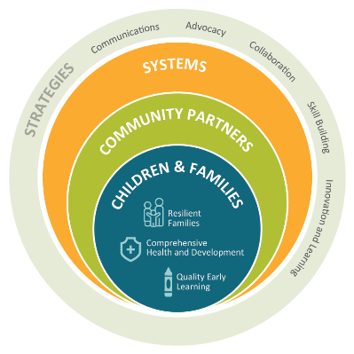
The Work of First 5 is Holistic and Aspirational
MISSION
First 5 builds the early childhood systems and supports needed to ensure California’s young children are safe, healthy, and ready to succeed in school and life
As a voice for the state’s youngest kids, we bring together partners and leverage multiple funding sources to strengthen systems of care through:
Communications
Advocacy
Collaboration
Skill Building
Innovation and Learning
So children and families have access to the community-based supports they need.
One day, California’s success will be measured by the wellbeing of its youngest children
VISION

Slide 15
Want to learn more?
Moira Kenney
Executive Director
First 5 Association of California
www.first5association.org
moira@first5association.org
(510) 227-6966

