Slide 1

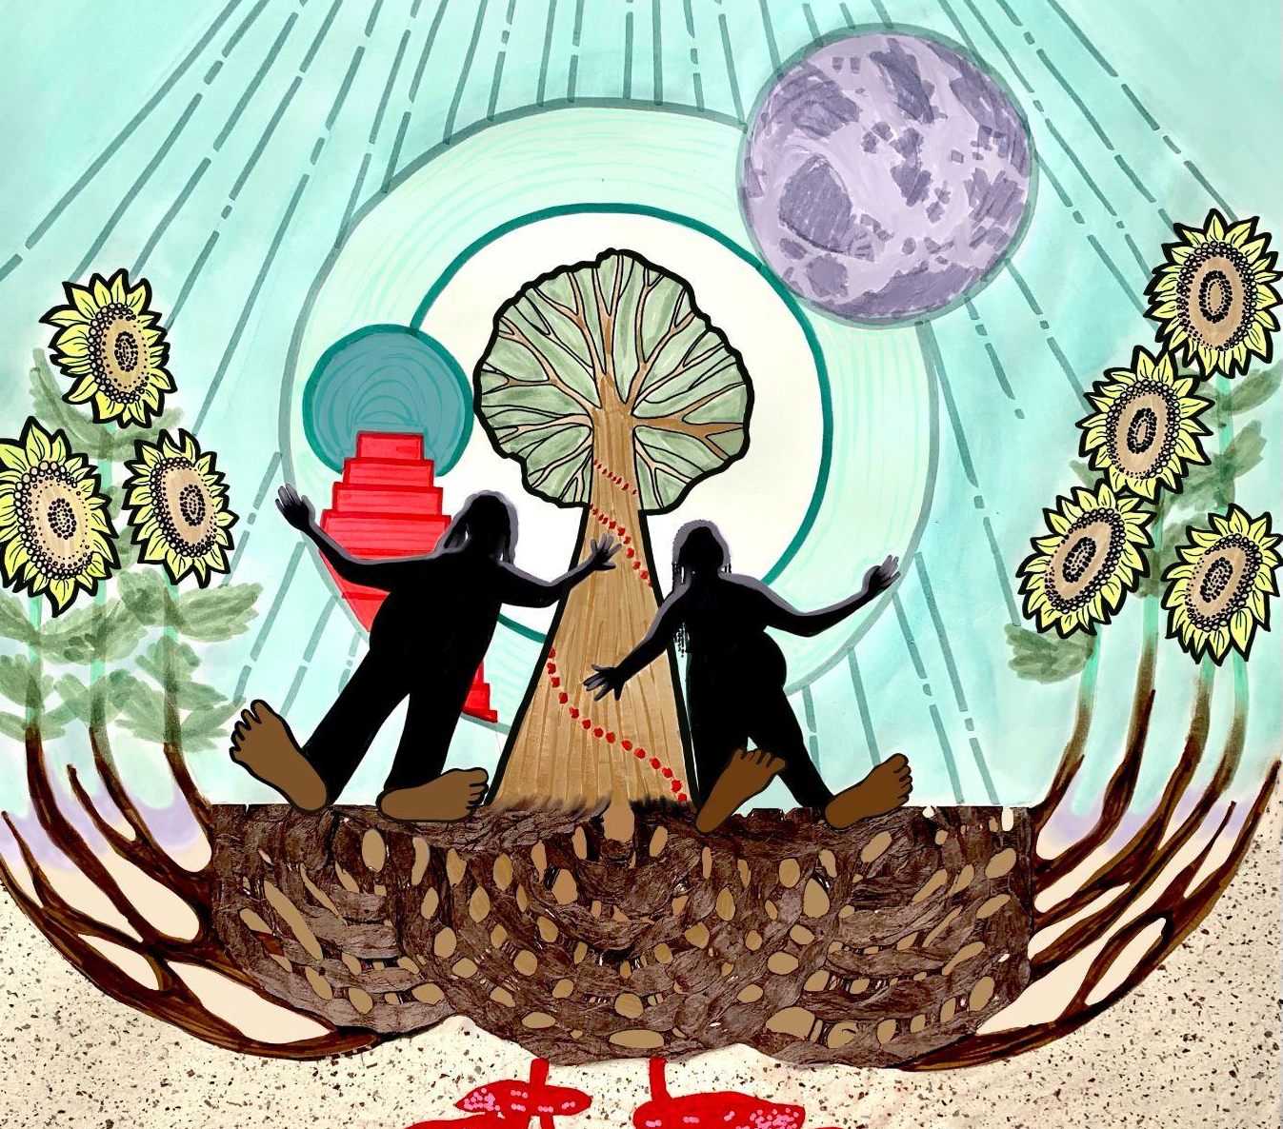
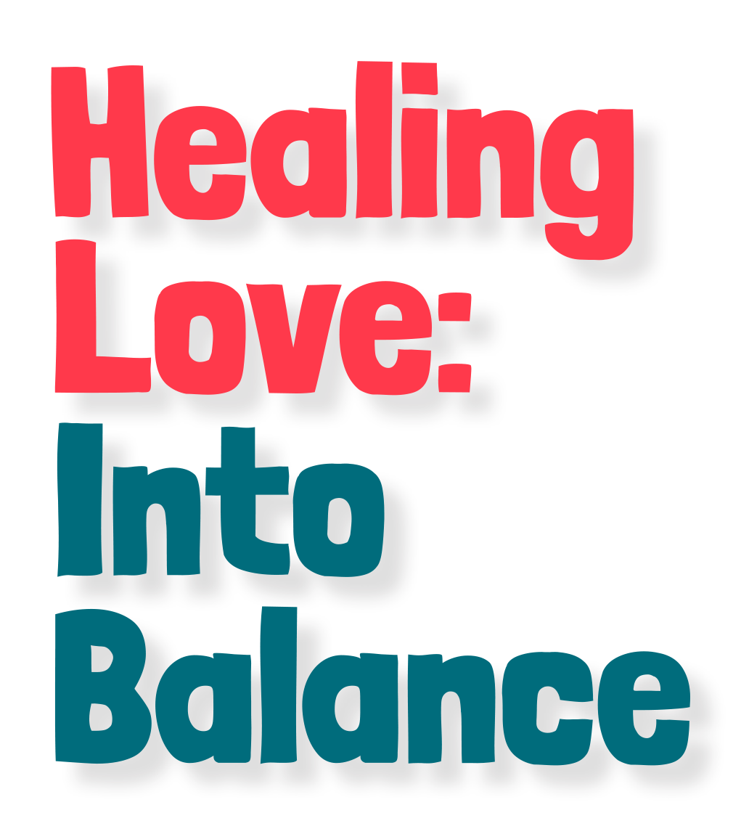
A Brown Paper

Slide 3



Slide 4
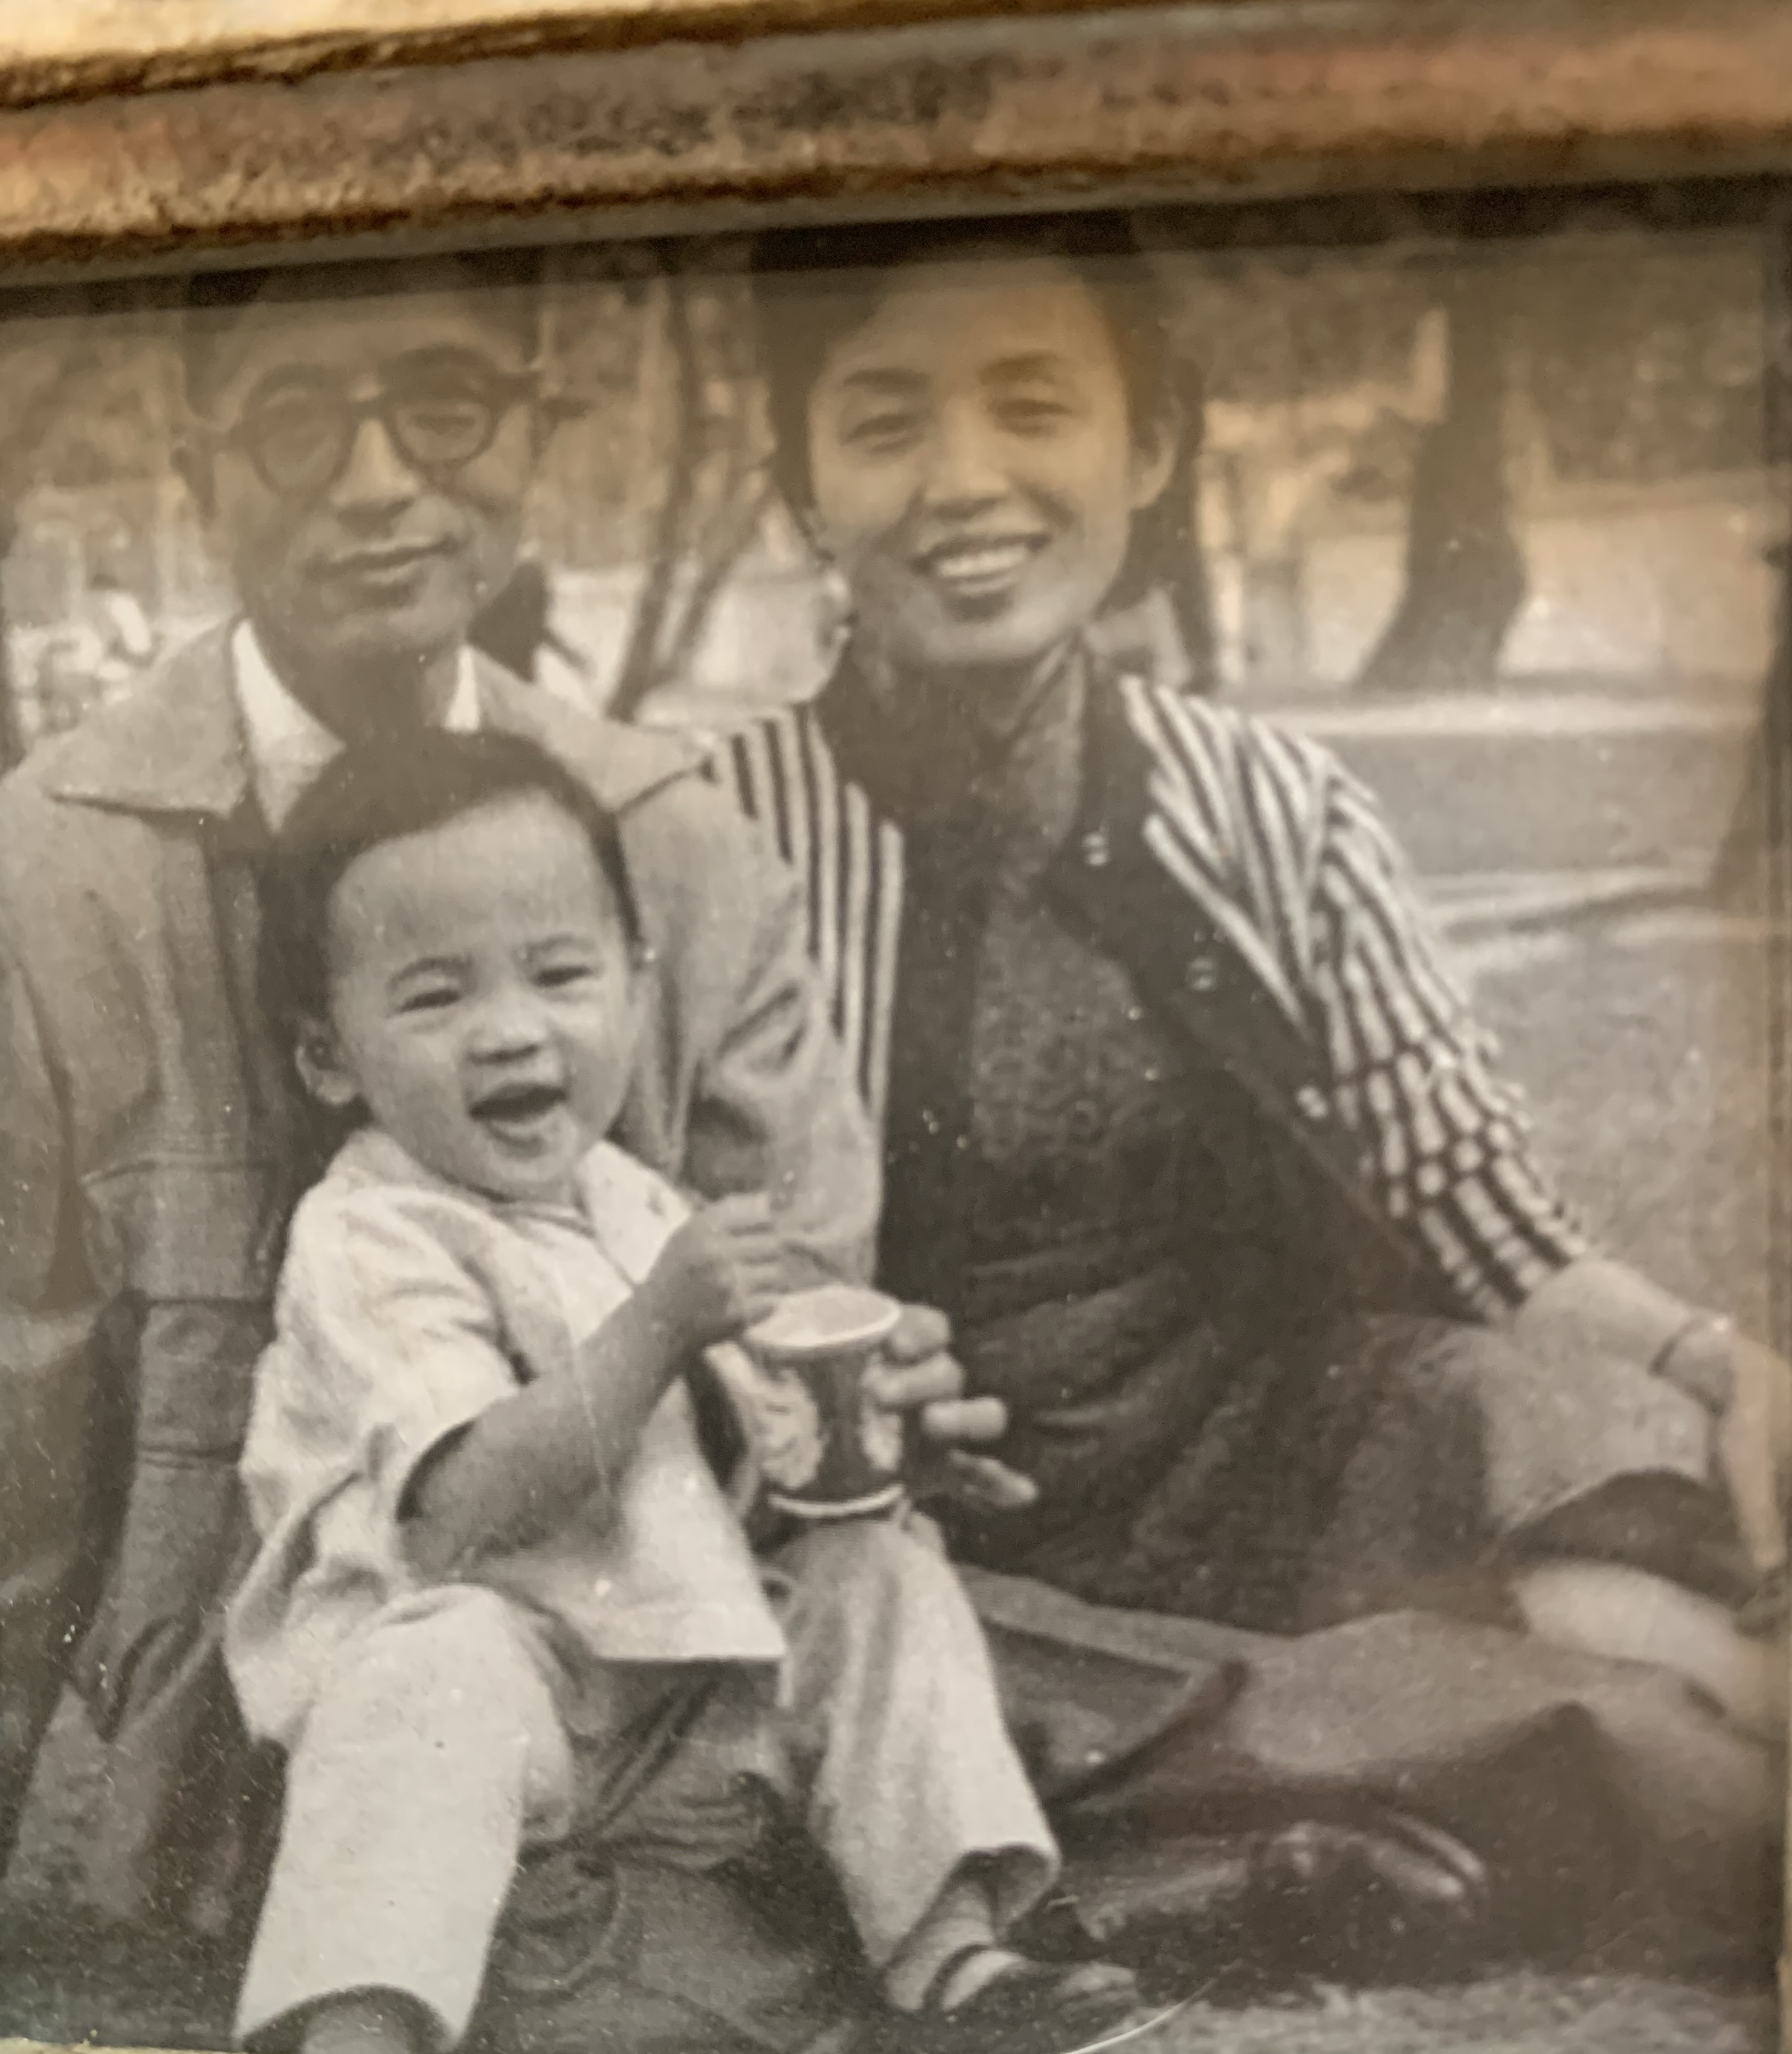

Slide 5
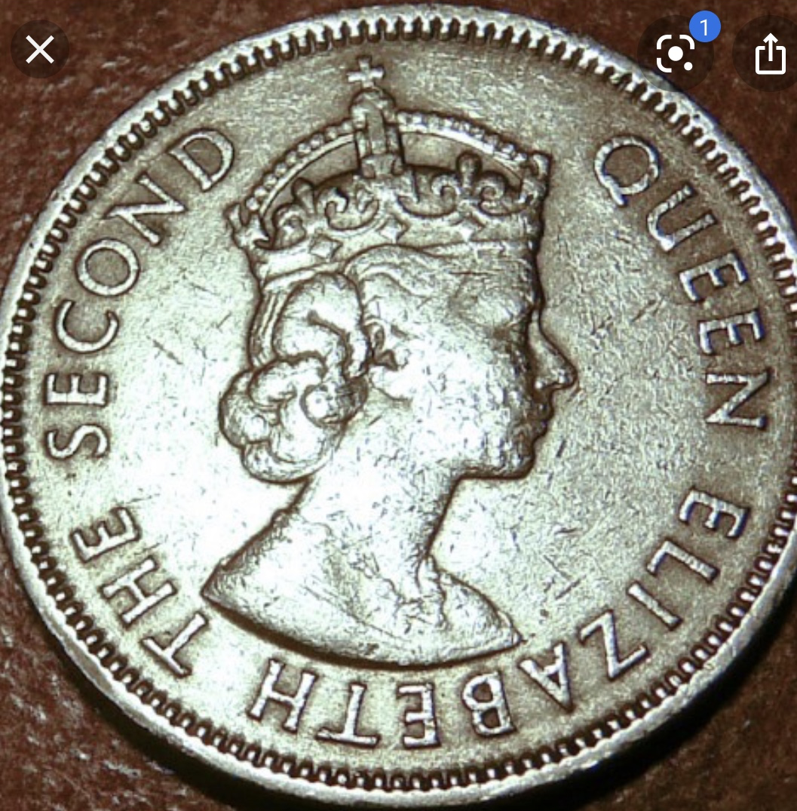

Slide 6
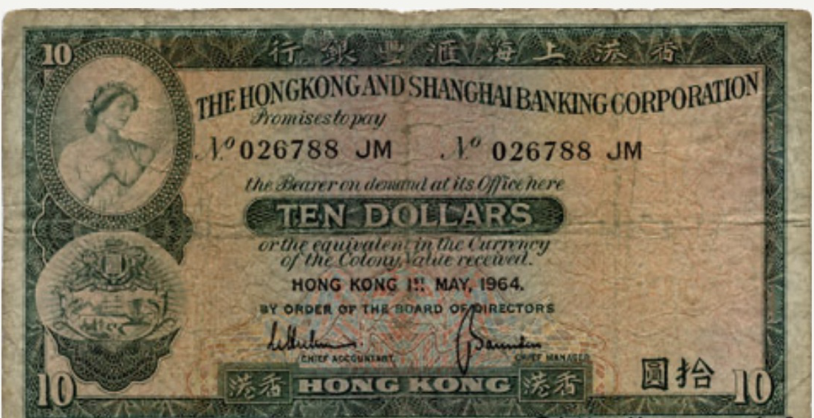

Slide 7


Slide 8


Slide 9


Slide 10
Reflect … and Discuss …
- Reflect on your life’s journey.
- What are 3 – 4 pivotal moments that shaped your sense of self ?
Share.

Slide 11


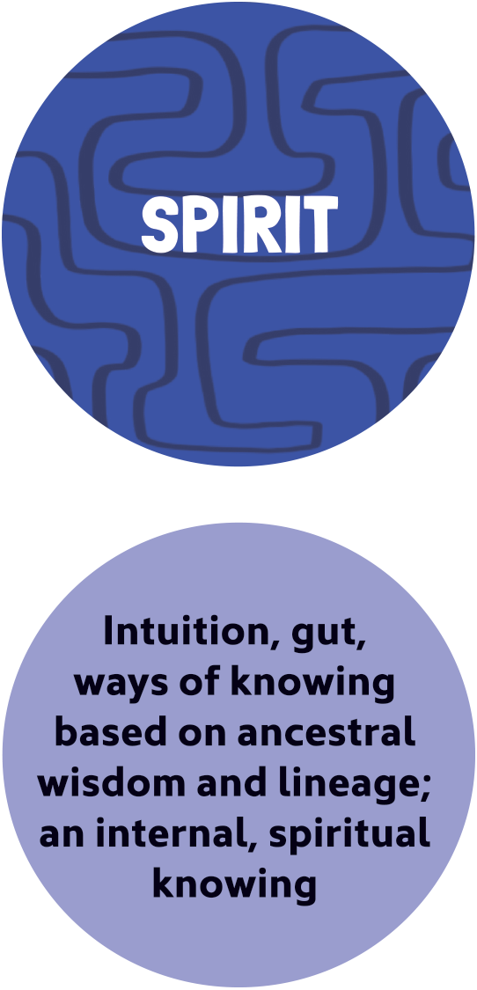

Slide 12
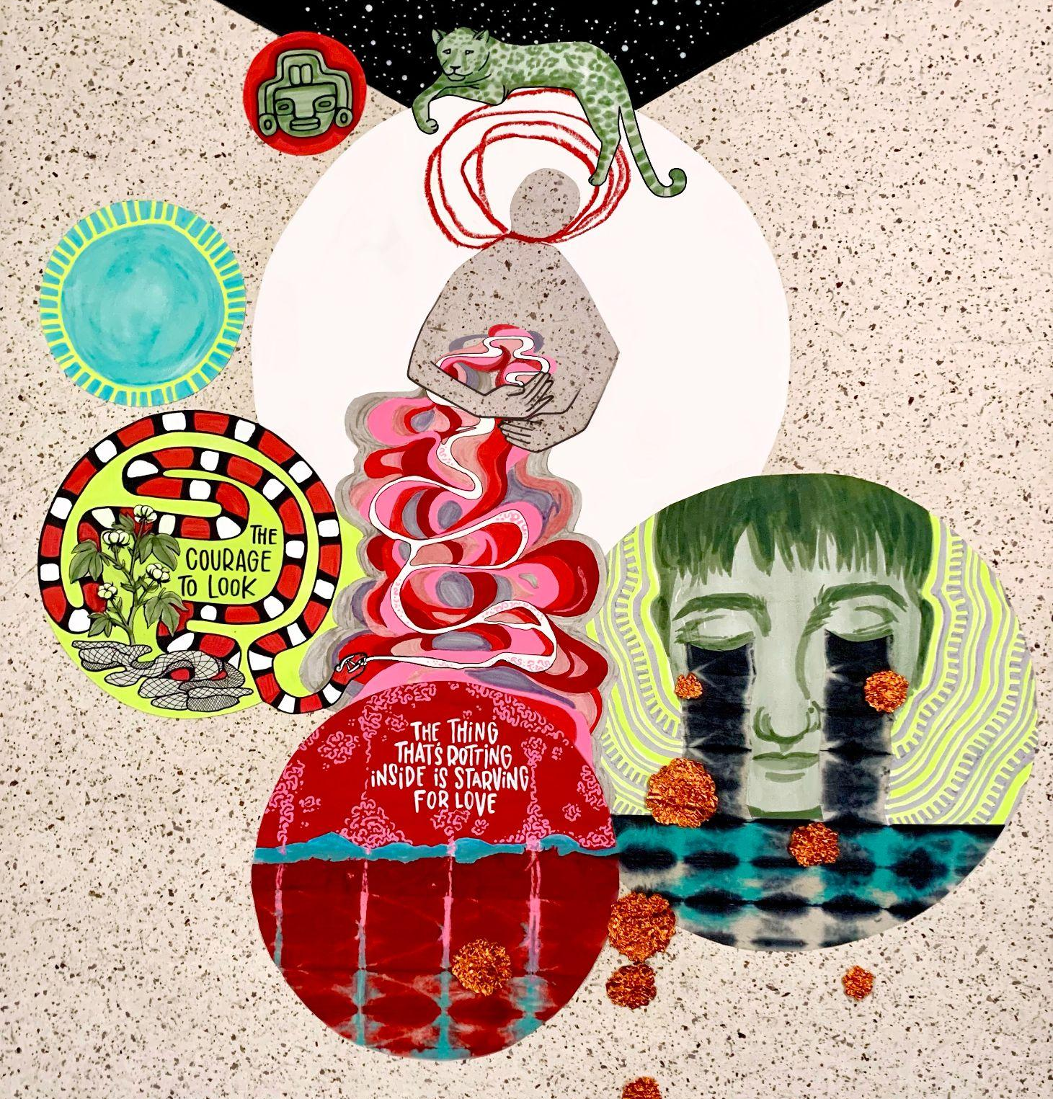

Radical Self-Love Means Embracing Light and Shadow

Slide 13
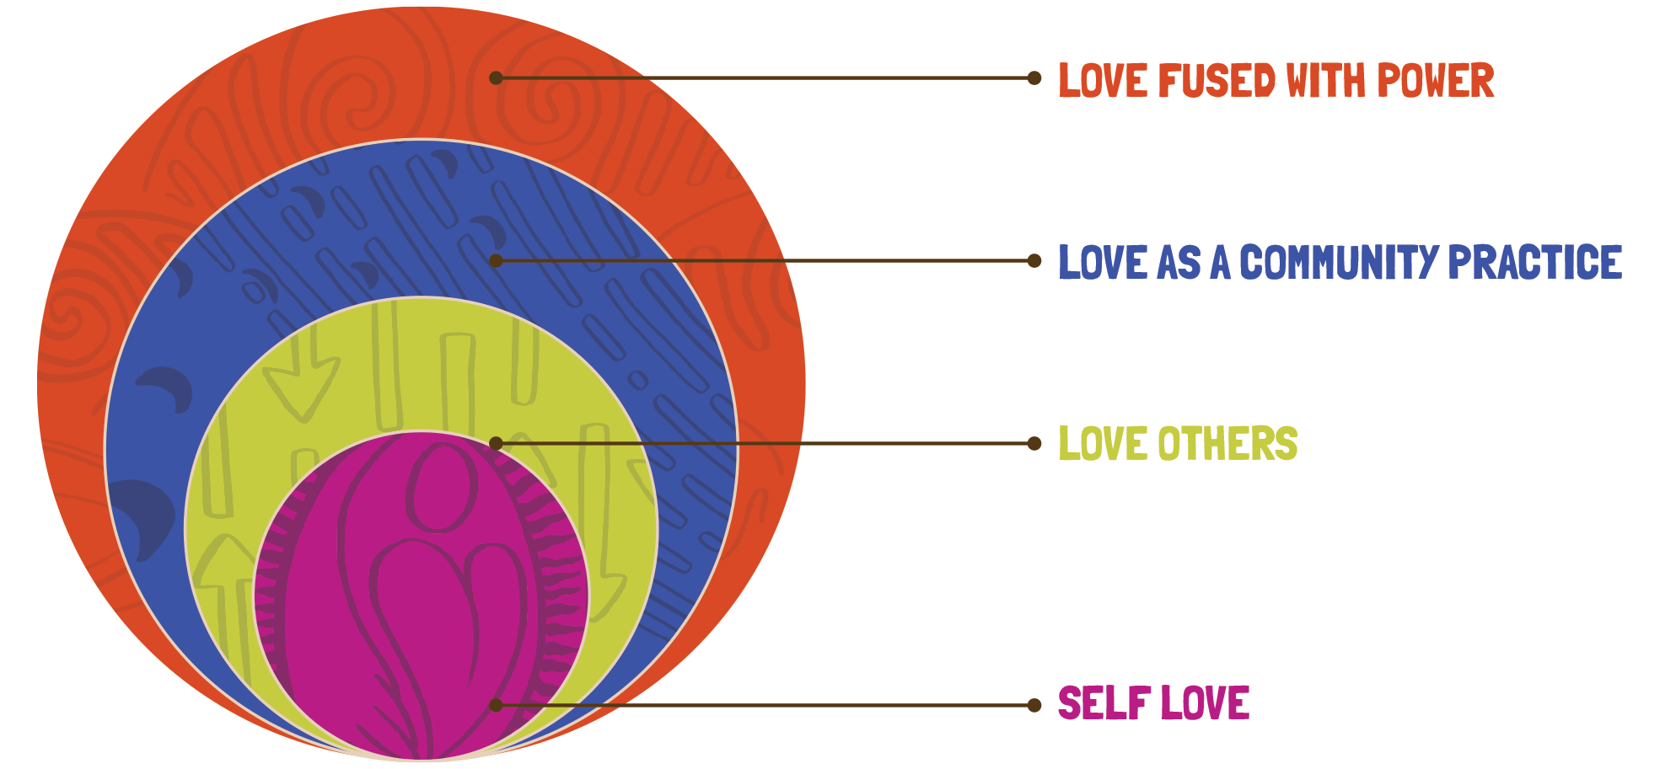

Slide 14








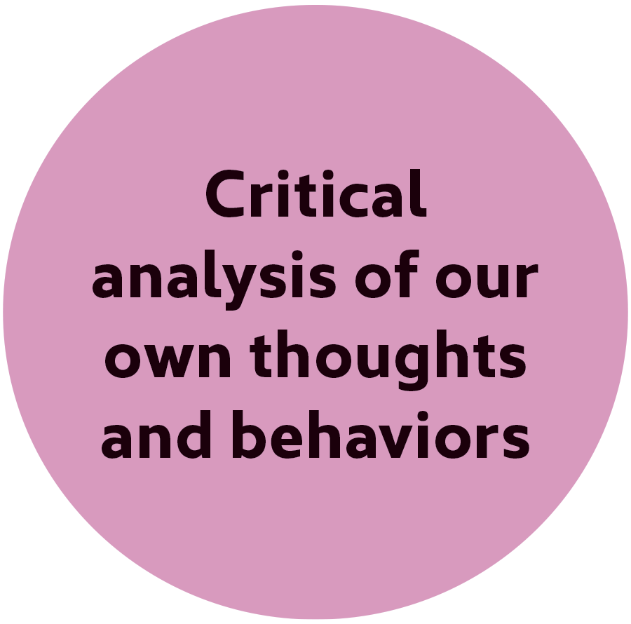
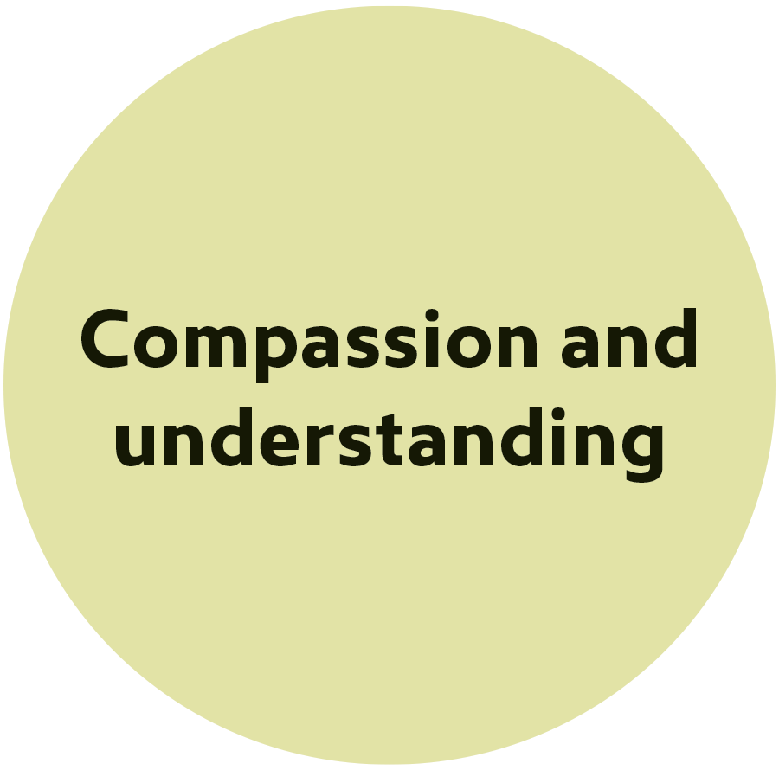


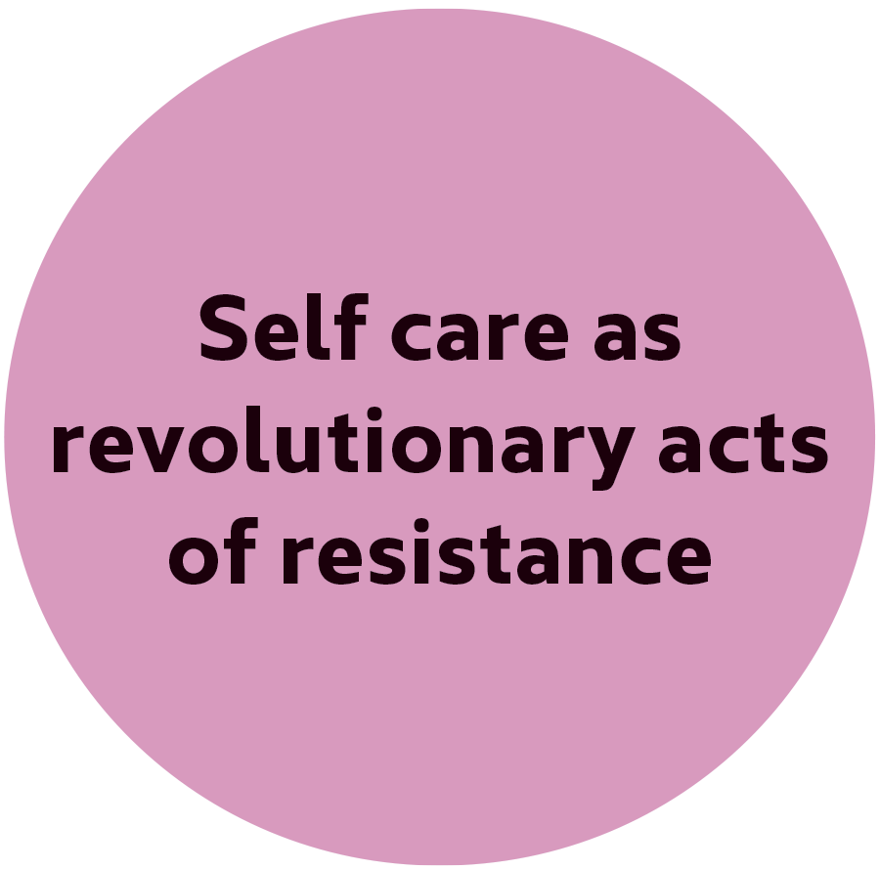
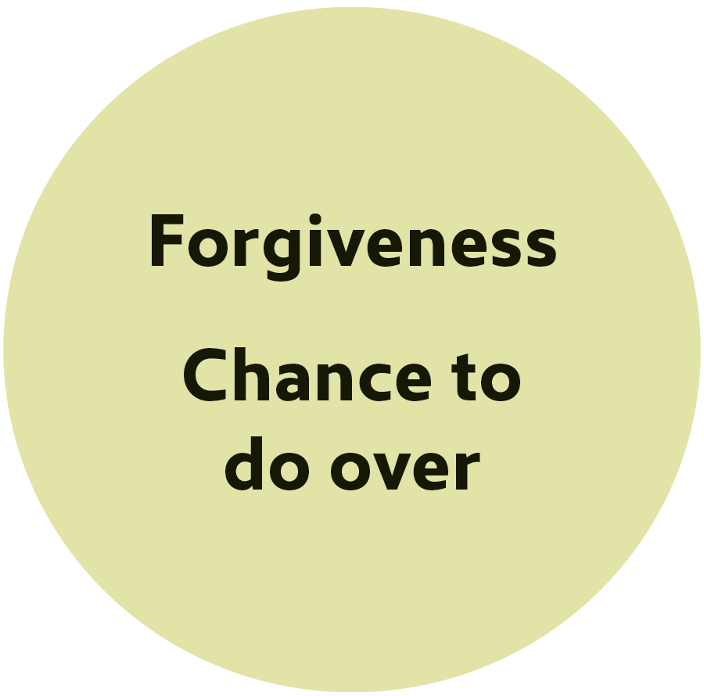



Slide 15
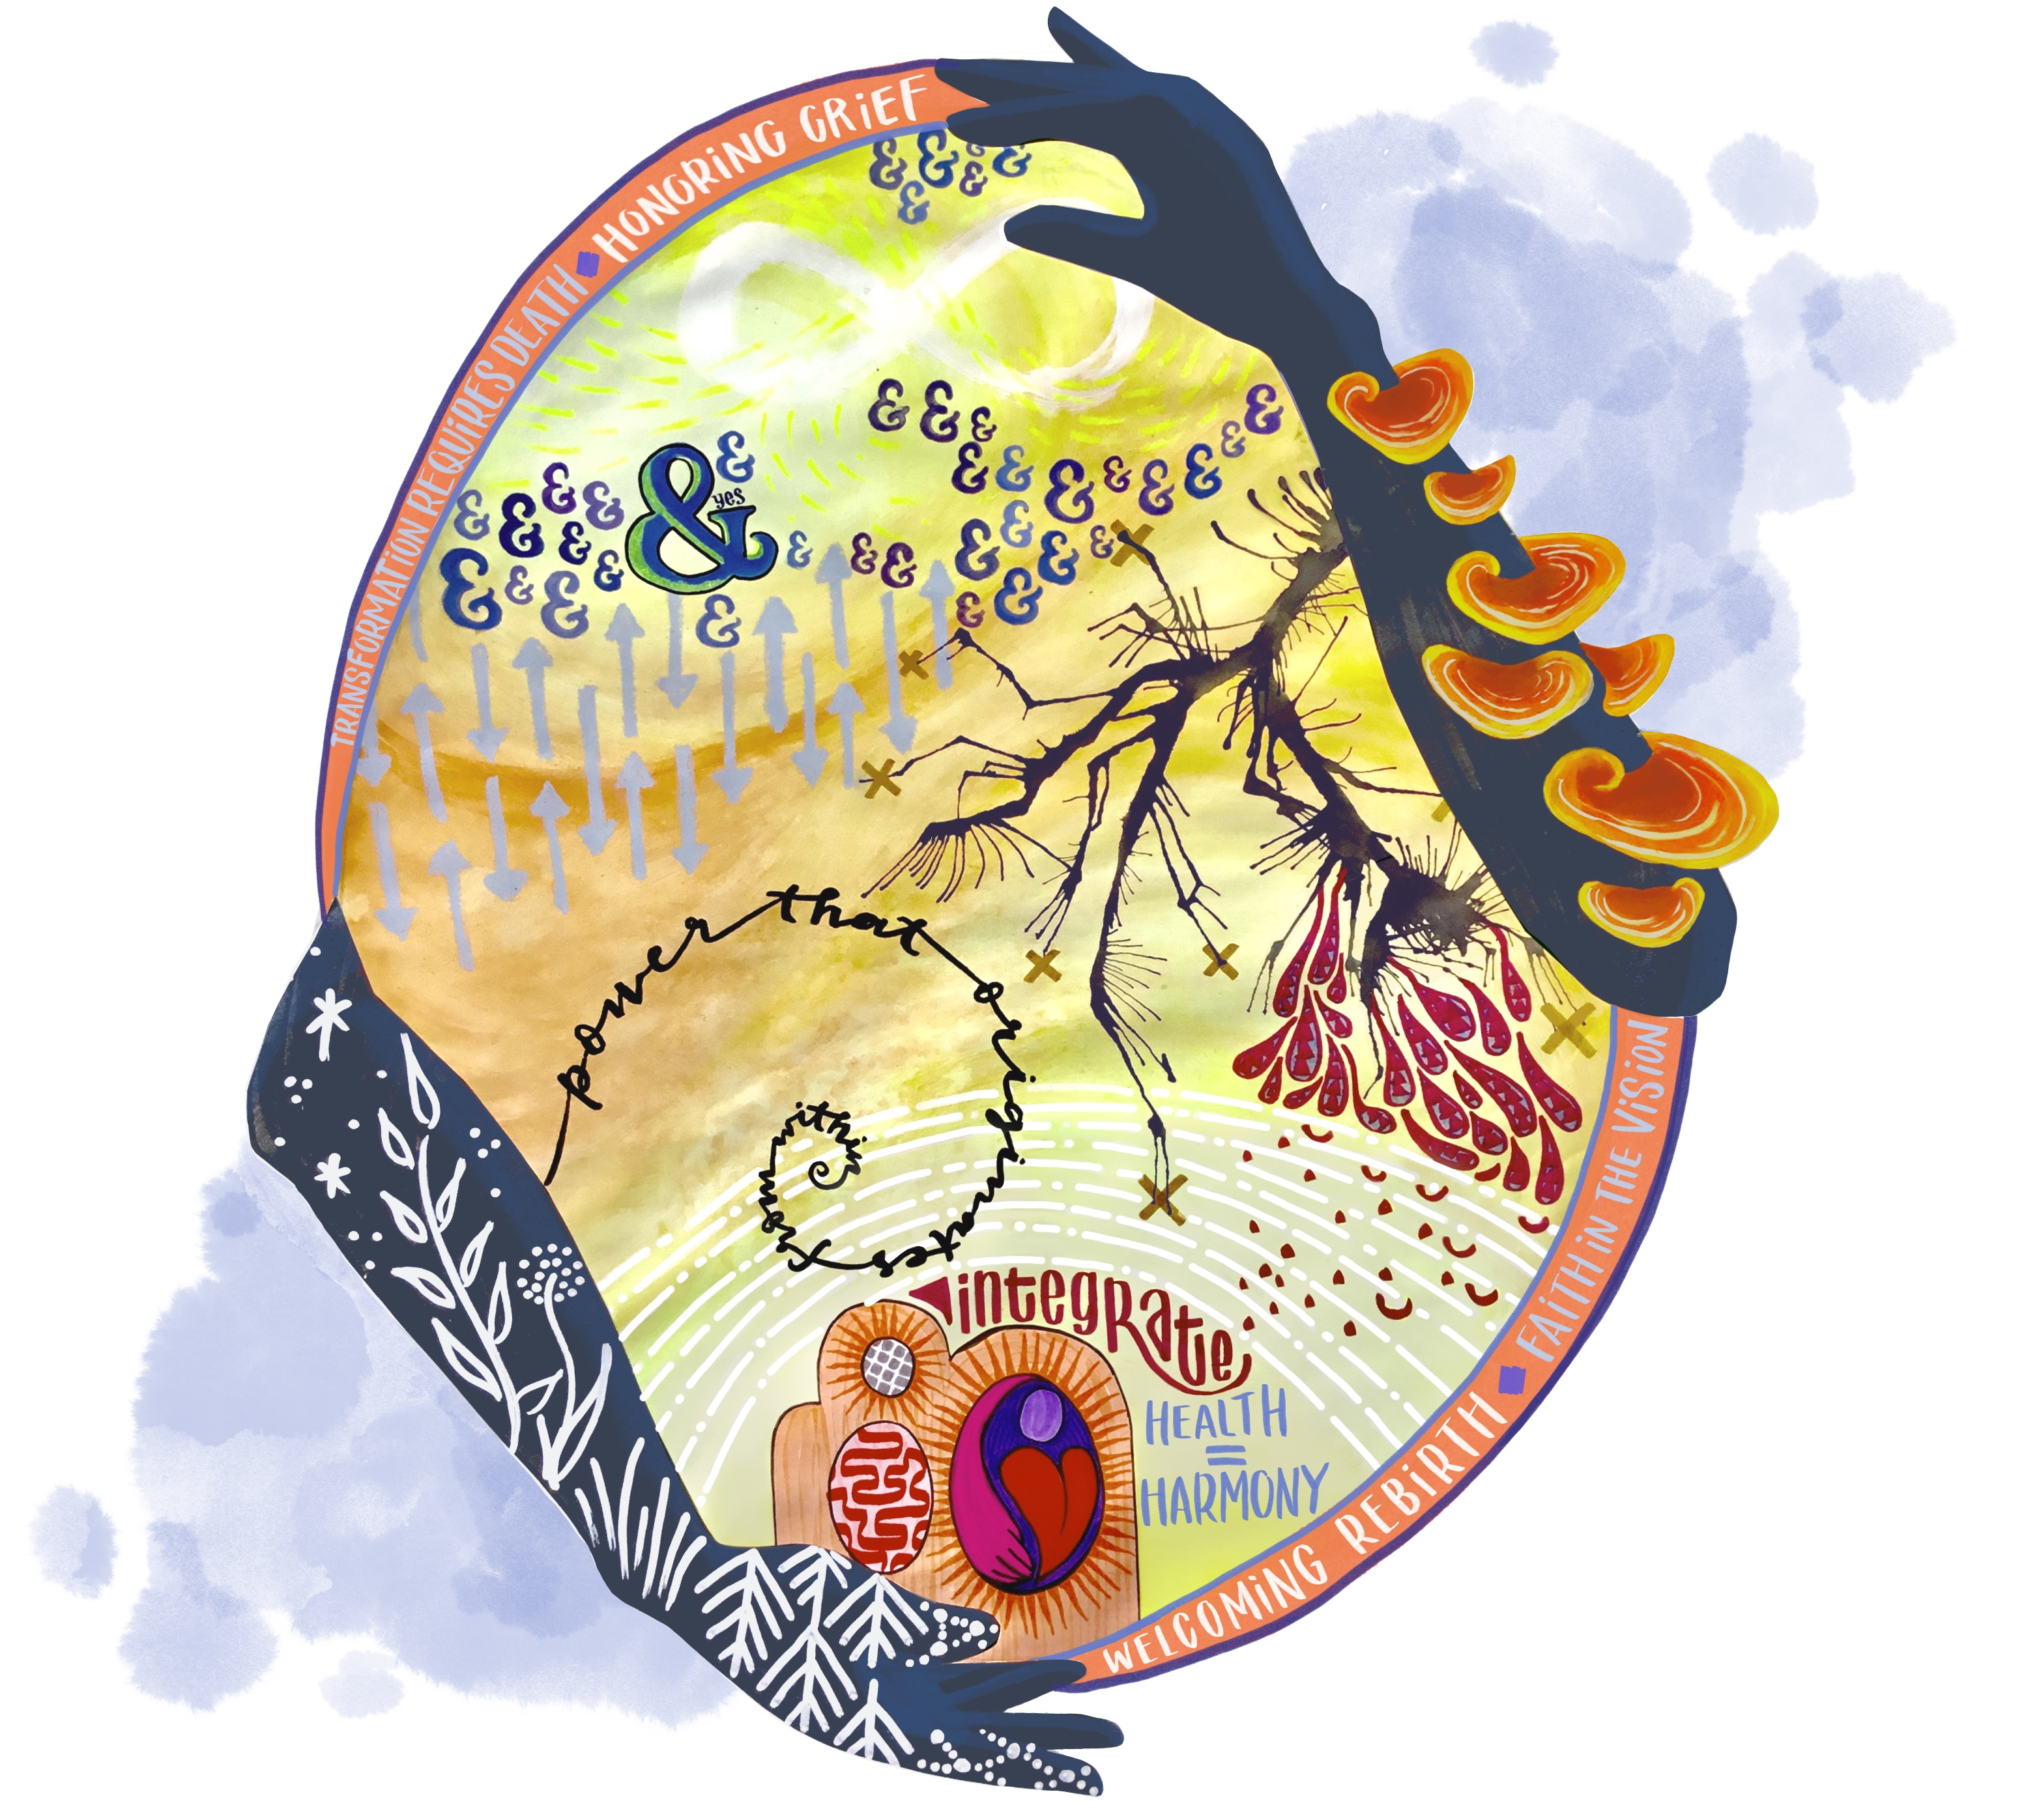
How radically are you loving yourself?

Slide 16
In pairs…
Please discuss how you’re radically loving on yourself these days…
What helps you in loving yourself?
What behaviors or thoughts don’t help?

Slide 17


