Slide 1
FAMILIES LEAD CALIFORNIA
Bay Area Early Childhood Funders
LEARNING SESSION
4/30/21

Slide 2
Engage in a rich funder practice discussion centered on sharing power with community using our Families Lead California Initiative as a use case
OBJECTIVE
Notes:
September

Slide 3
QUICK CONTEXT
HEISING-SIMONS FOUNDATION
EDUCATION PROGRAM
FAMILIES LEAD CALIFORNIA
GOALS - What
PROCESS – How
REFLECTIONS
PEER SHARING AND DISCUSSION
AGENDA
Notes:
September

Slide 4
ABOUT THE HEISING-SIMONS FOUNDATION
PROGRAM AREAS
EDUCATION PROGRAM
NORTH STAR
Notes:
September?

Slide 5
WHY NOW? BACK TO NORMAL IS FAILURE
Notes:
Malia
How has the Foundation responded to the multiple pandemics of 2020, and how did that lead the Foundation to FLC?
- Inequities laid bare as a result of the pandemic
- A reckoning with racial justice
- Families facing acute and long term challenges as a result
- “Normal' approaches and systems are what got us to this point of inequity – as we begin the long process of recovery – setting our sights on transformation
- The same kinds of solutions will lead to the same inequities – to get different outcomes we need to do something different

Slide 6
FAMILIES LEAD CALIFORNIA
Notes:
Malia
Families Lead California is one way to do something different - It is an initiative that recognizes:
1. that families know what they need and know what their children need to thrive
2. that the solutions that will help families of young children recover from the pandemics will emerge from families lived experience and parent-led organizations that are closest to that experience
3. that in the service of equity - funders must do things differently to share and build power of parent leaders

Slide 7
GOALS
Strengthen the pipeline of diverse parent leaders
Build the power of parents with young children
Nurture a network of leaders amplifying voices of parents of color
Programs and policies reflect parent priorities
Notes:
Malia

Slide 8
THE WHAT
$2.7 million dollars for 9 - 12 grants
$225K-$300K grant range
3-year grant term beginning in July of 2021
Unrestricted funding
Open call application with 6 week response window (80+ strong responses)
Notes:
September
Grant sizes set based on organizational budgets and plans described in the applications
Intent is for funding to be unrestricted – we are not using the term "general support" because some applicants may be fiscally sponsored, etc.

Slide 9
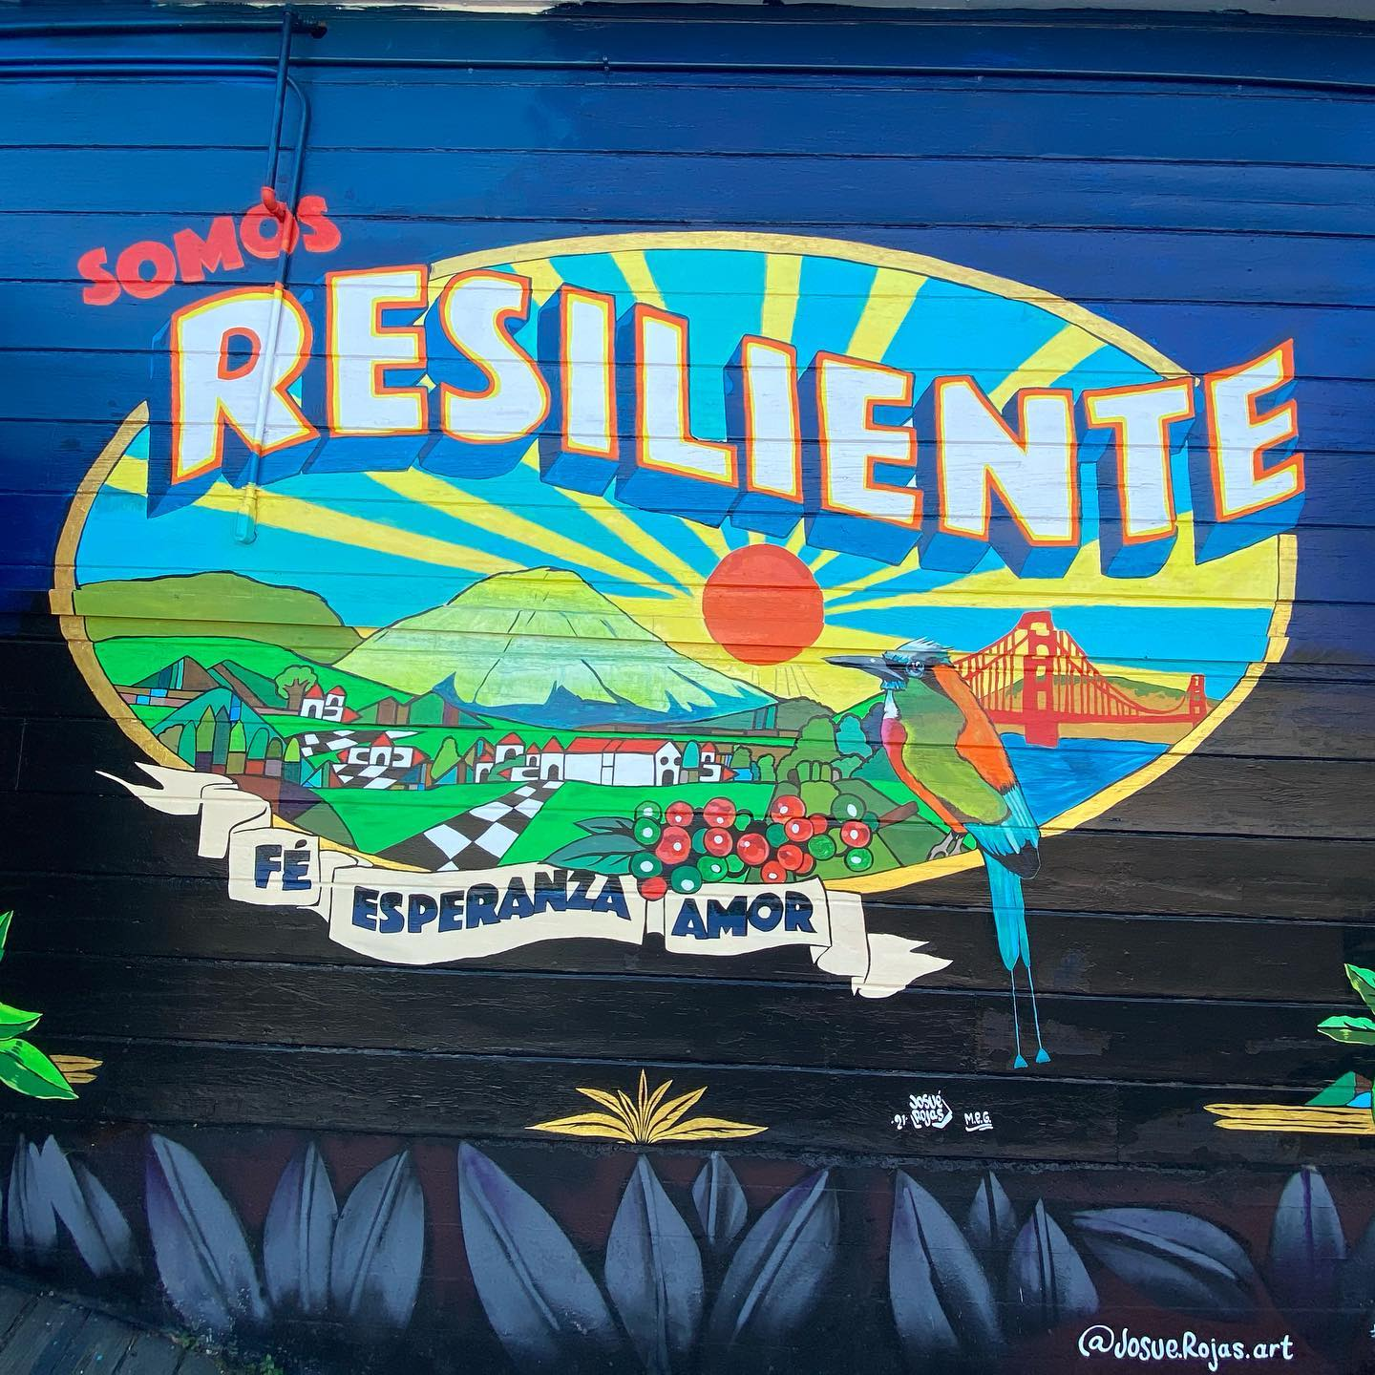
THE HOW
Consultant conducted scan to inform strategy, and Request for Applications
Rubric developed
Staff reviews to narrow to top 25
Diverse pool of parent leaders from outside CA (Community Advisors) identified top 12
Finalist panel interviews with staff and Community Advisors
Streamlined due diligence requirements
Standard board recommendation, in process
Notes:
September

Slide 10
THE MAGIC:
Community Advisors
Experienced consultant recruited and supported a diverse cohort of 13 advisors
Job Description provided clear guidance on role
Paid for time
Active support through process from consultant
Insights on applications and interviews invaluable
Notes:
Malia

Slide 11
ADDITIONAL SUPPORTS TO BE CO-CREATED WITH GRANTEES
Grantee convenings
Customized organizational support
Evaluation & reflection
Notes:
September

Slide 12
REFLECTIONS (to date…)
DO AGAIN
Cross team collaboration
Open call Request for Applications
Engage Community Advisors and share power in decision making
Invest in a support infrastructure for Community Advisors to build community
Streamlined application and due diligence process
Notes:
September?

Slide 13
REFLECTIONS (to date…)
DO DIFFERENTLY
Slow down to foster deeper collaboration and innovation across teams in Foundation (IT, Grants Management, Legal)
Engage Community Advisors earlier in process
In design of Initiative or Request for Applications
Identify an on-going role with Community Advisors
Notes:
Malia?

Slide 14
?
DISCUSSION

Slide 15
Discussion Prompts
What grant practices have you used to shift and share power with community?
What has worked well?
What has not worked well?
What more learning might we want to do together?

Slide 16
GRATITUDE FOR THE OPPORTUNITY TO SHARE AND LEARN TOGETHER
Families Lead California webpage: https://www.hsfoundation.org/programs/education/families-lead-california/

