Slide 4
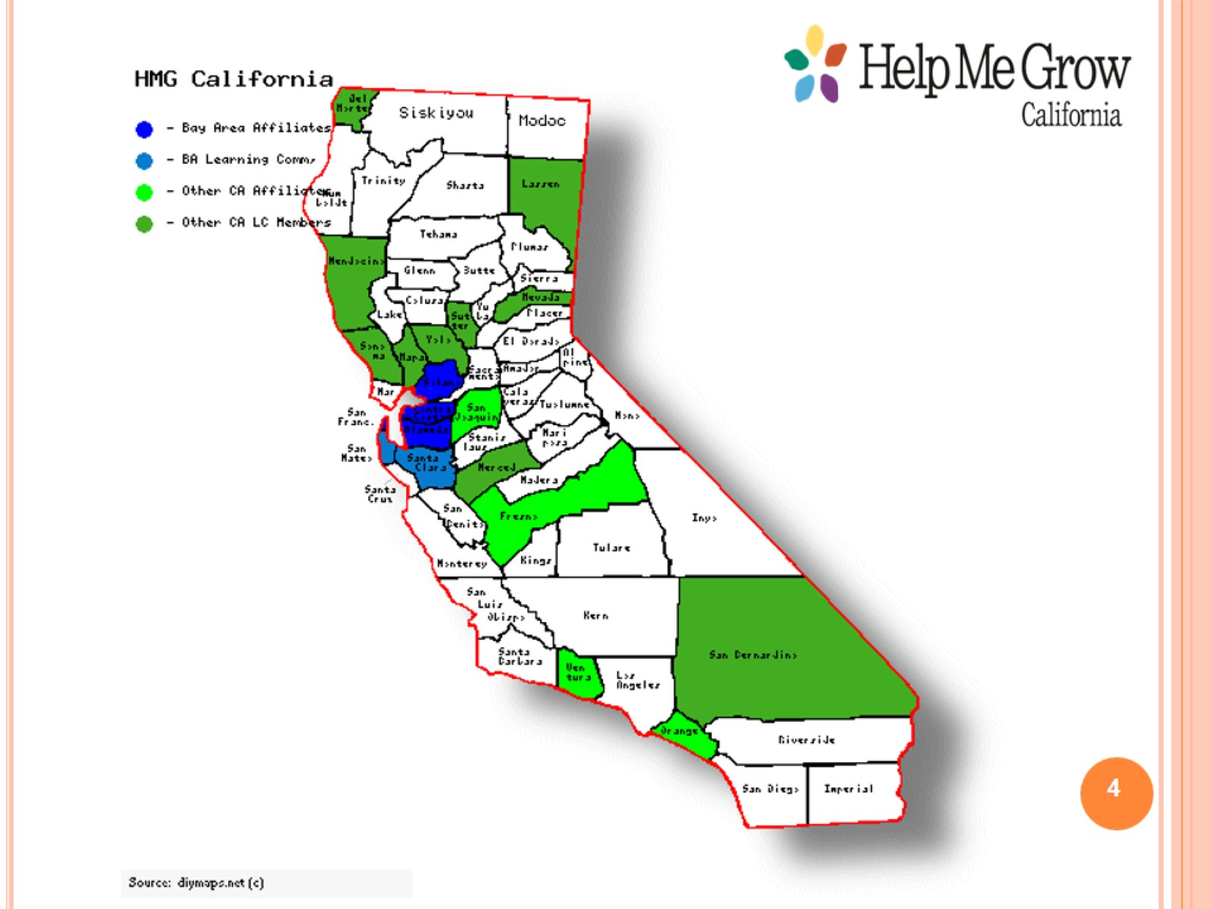

Slide 15
Family Story

Slide 16
