Slide 1
A Life Course Framework for Improving the Lives of Disadvantaged Populations
Arnold Chandler | Forward Change
Notes:
What I’ll be presenting today is a “Life course framework for improving the Lives of Disadvantaged Populations.”
Although it will focus on the lives of boys and men of color, much of what I talk about in the latter half of this presentation is applicable to girls and women.

Slide 2
Overview
Understanding How Structural Changes Have Produced Intergenerational Cycles of Disadvantage
A Life Course Framework for Improving the Lives of Disadvantaged Populations: Interrupting the Cycle
Notes:
Overall this presentation really defines the “Problem Space” for males of color. It lifts up the main factors that the evidence suggest drives their outcomes and focuses on areas where we need to intervene to change those outcomes.
The presentation is provided in two main parts.
The first part, “Why a Focus on Boys and Men of Color”, presents the challenge before us. It weaves together research on major changes in our economy, in our criminal justice policies and shifts in our families and neighborhoods over the past 40 years that have affected the outcomes of boys of color in ways that are different in many respects from those of their sisters. That is not to say that these same changes haven’t affected girls of color in ways different from and worse than boys, only that there are distinct differences that give rise to a need to look at these population separately and intervene in ways that ensure both of their outcomes improve.
The second part of the presentation, “A Life Course Framework for Improving the Lives of Disadvantaged Populations”, I present what the research says are the main drivers of outcomes for disadvantaged populations using a “life course approach” where we consider how earlier outcomes shape later ones and how contextual factors impact the trajectory of one’s life outcomes over time.

Slide 3
First Major Structural Shift: Declining Male Employment and Earnings
Notes:
One of the biggest reasons to look at what’s happening with males of color is what’s happening around their employment and earnings.

Slide 4
Vicious Cycles of Intergenerational Disadvantage
Since 1970 long-term joblessness has increased 180% among black and white males and 140% among Latino males due to changes in the economy.
Declining Employ and Earnings
Winters and Hirsch, 2012

Slide 5
Demand-Side Shifts in Employment
Technological Change
Declining Employment and Earnings
Off-shoring of middle-skill jobs and import competition (China)
$
Decline in Unions
Suburbanization of low-skilled jobs (“spatial mismatch”)
Legal discrimination against felons
Illegal Employment Discrimination in Low-Wage Jobs
Autor and Wasserman, 2013
Notes:
A handful of critical factors have been identified that are driving a pronounced rise in long-term unemployment (what I call “joblessness”) since the 1970s among not just males of color, but all males regardless of race and ethnicity.
These factors include:

Slide 6
Second Major Structural Shift: Mass Incarceration
Notes:
In addition to the decline in employment and earnings over the past few decades is the rise in Mass Incarceration which as I mentioned before has contributed significantly to this decline in employment and earnings, particularly for black males who don’t graduate from college.

Slide 7
Vicious Cycles of Intergenerational Disadvantage
Since 1970 long-term joblessness has increased 180% among black and white males and 140% among Latino males due to changes in the economy.
2 out of 5 of black males were jobless in 2010 as were 1 in 4 native-born Latinos
Declining Employ and Earnings
U.S. imprisonment rates increased
430 percent
between 1972
and 2012 due to policy changes and shifts in prosecutor behavior
Mass Incarceration and the
War on Drugs
Sourcebook of Criminal Justice Statistics Online; Travis & Western, 2014

Slide 8
2.3 million in prisons
or jails (2012) BJS
Imprisonment increased by 430 percent between 1973 and 2010
Due to policy decisions that:
Increased prison Admissions
Increased Sentence Lengths
Start of Era of Mass Incarceration
Felony conviction and/or imprisonment reduces lifetime earnings and employment by 10-30 percent (Travis & Western, 2014)
1 in 10 (12.1%) of adult males and 1 in 3 adult black males (33%) have a felony record (Shannon et al, 2017)
+430%
Sourcebook of Criminal Justice Statistics Online

Slide 9
90%
12%
Western and Pettit, 2010, for California Raphael, 2007
Notes:
This slide really is meant to convey a critical point about the effect of educational attainment on the risk of going to prison for black males.
Black males who drop out of high school have a nearly 70% chance of going to prison in their lifetime. [CLICK]
However, black males who graduate from high school or get their G.E.D. have just a 21% chance of going to prison in their lifetime. That is a 47 percentage point difference!

Slide 10
Third Major Structural Shift: The Rise of Disadvantaged Families
Notes:
In addition to Declining Employment and the rise of Mass Incarceration, the Rise in Disadvantaged Families plays a big part in the outcomes of males of color over the past 40 years.

Slide 11
Vicious Cycles of Intergenerational Disadvantage
Since 1970 long-term joblessness has increased 180% among black and white males and 140% among Latino males due to changes in the economy. 2 out of 5 of black males were jobless in 2010 as were 1 in 4 Latinos (native born)
Declining Employ and Earnings
U.S. imprisonment rates increased
430 percent
between 1972
and 2012 due to policy changes and shifts in prosecutor behavior
Mass Incarceration, Joblessness and Male Mortality have produced a sharp increase in single-parent families
Mass Incarceration and the
War on Drugs
Growth of Disadvantaged Families

Slide 12
Census Bureau:
https://www.census.gov/cps/methodology/techdocs.html

Slide 13
Children Living in Single Parent Families
In 2013, the Percentage of Children Living in Single Parent Families
11%
18%
32%
40%
58%
Asian Children
White Children
Latino Children
American Indian Children
Black Children
SOURCE: 2013 Data from p. 16 Status and Trends in the Education of Racial and Ethnic Groups 2016 (NCES)
Notes:
Such that in 2012:
1 in 5 white children lived in single parent families
Around one-third of Latino children; and
Over half of black children

Slide 14
Vicious Cycle of Intergenerational Disadvantage
Since 1970 long-term joblessness has increased 180% among black and white males and 140% among Latino males due to changes in the economy. 2 out of 5 of black males were jobless in 2010 as were 1 in 4 Latinos (native born)
Growing up in a poor or single-parent family, especially with an incarcerated father, significantly worsens behavioral, educational and employment outcomes, among males
Declining Employ and Earnings
Human Capital & Socioemotional Skill Deficits
U.S. imprisonment rates increased
430 percent
between 1972
and 2012 due to policy changes and shifts in prosecutor behavior
Mass Incarceration and the
War on Drugs
Growth of Disadvantaged Families

Slide 15
Gender-Specific Effects of Family Disadvantage on Educational and Employment Outcomes
Growing up in a single-parent family:
Reduces college attendance for boys, but not for girls (Jacob, 2002)
Increases juvenile delinquency among boys, but not girls (Cobb-Clark, 2011)
Increases behavior problems significantly more among boys than girls (Bertrand and Pan, 2011)
With an incarcerated father increases behavioral problems much more among boys than girls (Wakefield and Wildeman, 2013)
Causes behavioral and academic outcomes between boys and girls to substantially diverge starting in Kindergarten: Based on a sample of 1 million Florida kids (Autor, 2015)
Causes a reversal of gender gap in the likelihood that males will work compared to girls. Boys raised in single parent families work less than girls as adults: Based on a U.S. sample of 5 million children and their parents. (Chetty, 2016)
Notes:
For example,
Read slides

Slide 16
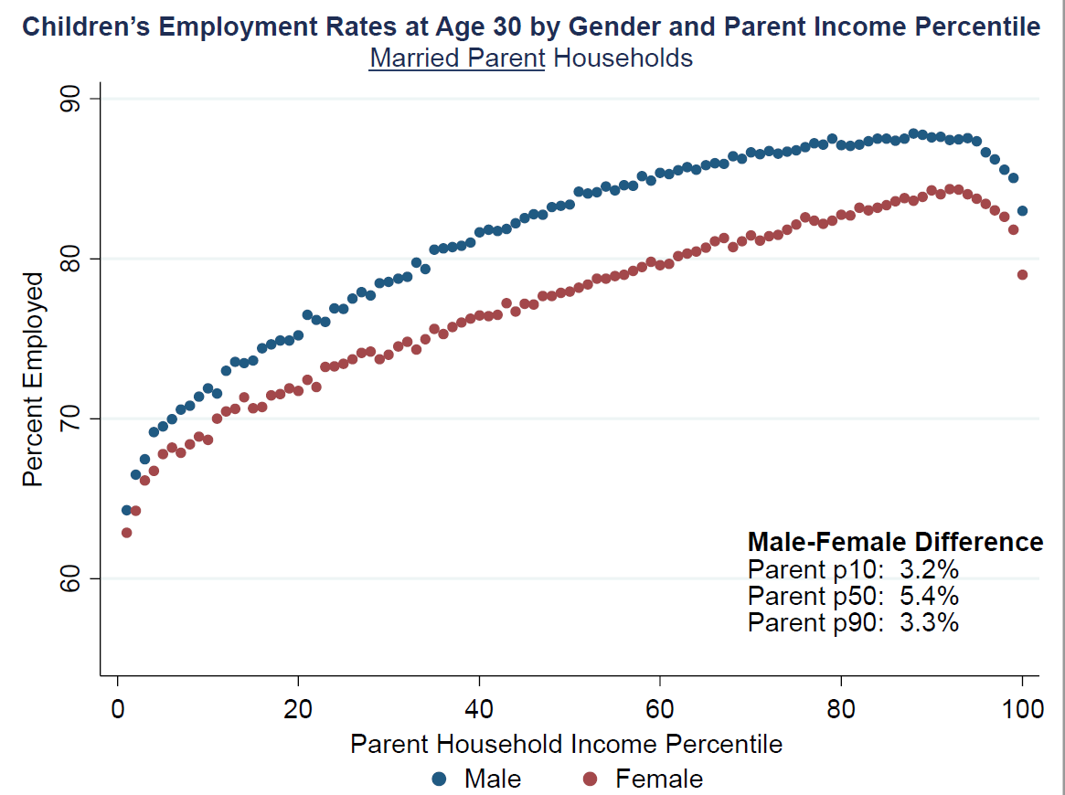
Chetty, 2016

Slide 17
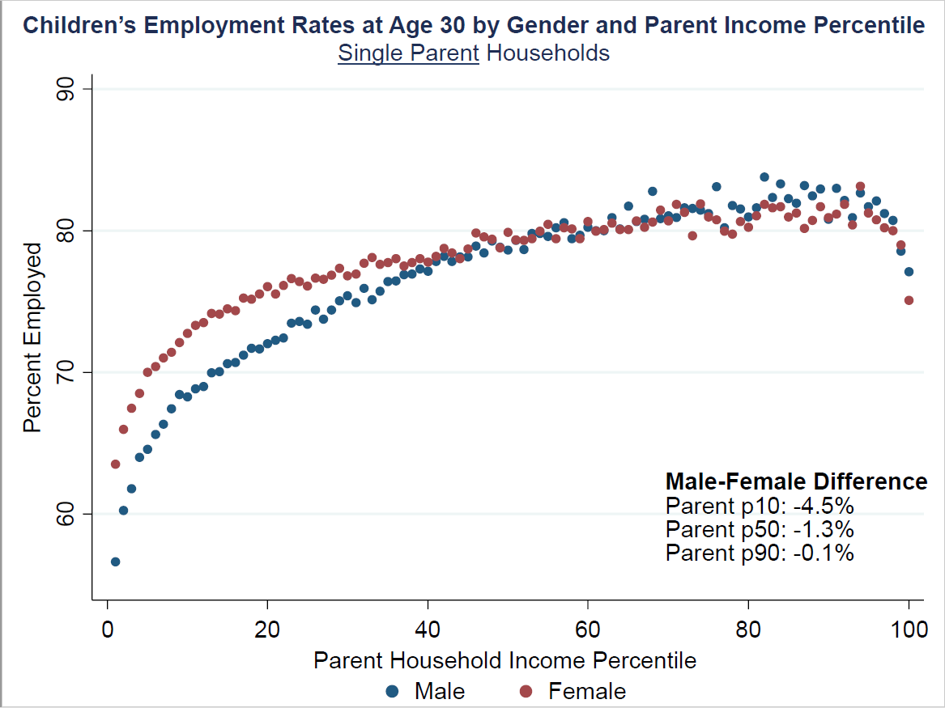
Chetty, 2016

Slide 18
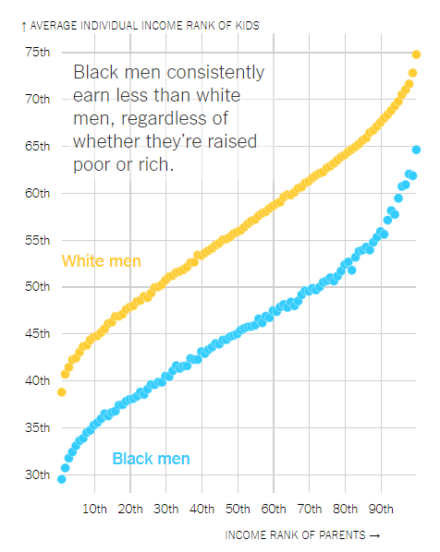
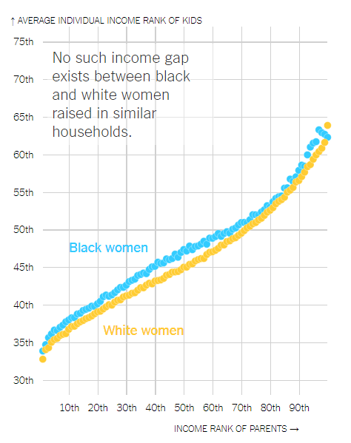
Income Mobility Based Upon Race and Gender
Men
Women
Intergenerational study using 20 million children and their parents.
Data are from IRS tax records and Census records
$63,180
-$14,450
$51,270
$48,730
$48,730
$55,150
$55,150
SOURCE: New York Times, “Extensive Data Shows Punishing Reach of Racism for Black Boys”

Slide 19
Vicious Cycle of Intergenerational Disadvantage
Declining Employ and Earnings
Human Capital, Socioemotional Skills, & Social Capital Deficits
Mass Incarceration and the
War on Drugs
Growth of Disadvantaged Families

Slide 20
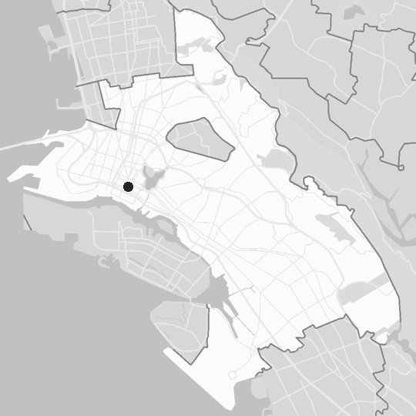
Place is foundational to
American racial and
social inequity
Oakland, CA
Rise of concentrated disadvantage
Inequitable Exposure
Roughly 70% of black children live in high poverty neighborhoods compared to 6% of white children
(Sharkey, 2009) (HP=>20% poor)
The rise of concentrated poverty and jobless ghettos since the early 1970s due to economic decline, and racial & economic segregation (Wilson, 1996)
Concentration of negative factors associated with poverty like crime, violence, poor school quality, drugs, disinvestment (Massey, 2007)
Declining Employ and Earnings
Human Capital, Socioemotional Skills, & Social Capital Deficits
Inequitable Duration
The average black child will spend 50% of their childhood in high poverty neighborhoods, Latinos will spend 40% and whites, 5%.
(Timberlake, 2007)
Declining Employ and Earnings
Human Capital, Socioemotional Skills & Social Capital
Mass Incarceration and the
War on Drugs
Growth of Disadvantaged Families
Mass Incarceration and the
War on Drugs
Growth of Disadvantaged Families
Declining Employ and Earnings
Human Capital, Socioemotional Skills & Social Capital
Intergenerational Continuity
70 percent of black children that grow up in neighborhoods of concentrated disadvantage will live in those neighborhoods as adults.
(Sharkey, 2008)
Mass Incarceration and the
War on Drugs
Growth of Disadvantaged Families

Slide 21
A Life Course Framework for Improving the Lives of Disadvantaged Populations: Interrupting the Cycle
Notes:
The challenge I have just laid out suggests that the challenges with males of color operate through
gender-specific pathways,
is intergenerational and
is concentrated in neighborhoods of disadvantage
To interrupt this intergenerational cycle, we must examine the outcomes for males of color in more detail keeping in mind that these dynamics of disadvantage unfold over the course of their lives starting when they are young children and extending into young adulthood.

Slide 22
Overview of Framework Components
Environmental and experiential factors that interactively shape both human development and life course outcomes:
Families
Neighborhoods
Schools
Public Systems
Ecological and Contextual Factors
The institutional/competency milestones (“credentials”) that are tied to specific age spans:
School readiness
High School Graduation
Incarceration
Stable Full-Time Employment
Homelessness
What we start with (i.e. genetics) and what develops over people’s lives
Physical Health
Cognitive development
Mental Health
Socioemotional Skills
Dimensions of Human Development
Life Course Outcomes
Notes:
Our life outcomes are shaped by a multitude of weakly determining forces. There are no silver bullet causal factors and therefore no silver bullet solutions.
In a moment, I’m going to present you with the Life Course Canvas that visually depicts this in a less abstract way, but first I want to orient you to the major components of the framework:
The first major component is the “Dimensions of Human Development”. These are the genetic endowments we are born with from our parents as well as aspects of ourselves that develop over time that shape the “Life Course outcomes” that we have. These dimensions aren’t regularly measured and tracked and require special survey instruments or systematic observation to detect. They are things like intelligence, social skills, mental health, etc.
The second major component are “Life Course Outcomes” or the things that are more readily measured in society and that shape our likelihood of growing up to raise a family that is not itself poor. Things like school readiness, high school graduation, incarceration, etc.
The last, but not least major component are “Ecological and Contextual Factors” that shape both Dimensions of Human Development and our Life Course Outcomes. These factors, like the age of our parents when we were born, whether our families are poor, whether are parent are undocumented, etc. affect the start of our life journey and shape its trajectory over time.

Slide 23
Dimensions of Human Development
Physical Health: genetic predisposition; motor-visual-auditory dev, morbidity, physical frailty, brain development, biological embedding of social adversity and toxic substance exposures: chronic adversity, allostatic load/toxic stress, environmental toxin exposure (e.g. air pollution, lead poisoning, etc.), epigenetics, basal cortisol levels, addition
Identity Development: Self-concept, Self-Awareness, Mindset, self-efficacy, racial/ethnic identity, gender identity, sexual identity, cultural orientation/attachment; Sense of Belonging
Beliefs, Content and Cultural Knowledge: personal beliefs, Declarative, procedural and evaluative content and cultural knowledge.
Cognitive Development: fluid and crystallized intelligence, information processing, language, numeracy, literacy, executive functions (e.g. memory, attention, reasoning, problem solving), mathematical reasoning, scientific thinking, verbal and written communication skills
Meaning-Making/Spiritual Development: Global and Situational Meaning (e.g. "The Meaning-Making Model") including beliefs, goals, subjective sense of meaning; sense of “life’s purpose”; spiritual development and practice and/or religious affiliation and practice
Mental Health and Sense of Well-Being: secure attachment, trauma, happiness/contentment, hope, self-esteem/mastery, stigma stress, mood disorders, schizophrenia, PTSD, psychosis, addiction
Moral Development: conscience and moral agency, moral judgment, moral reasoning, altruism, empathy, moral action/behavior (Prosocial behavior), moral emotion, moral character (i.e. virtue, ethics)
Socioemotional Development: Emotion and behavior regulation; autonomy; determination; motivation; self-monitoring/meta-cognition
Personality: Openness, Conscientiousness, Agreeableness, Neuroticism
Notes:
SPEND LESS TIME ON THIS SLIDE

Slide 24
Dimensions of Human Development
Protective Factor
Physical Health
Cognitive Dev.
Mental Health
Socioemotional
Identity
Etc.
Risk Factor
© Forward Change Consulting

Slide 25
Society, Culture & History
Institutions and Public Systems
Place
Peers, Mentors and Networks
Schools and Childcare
Family
0-5
6-11
12-18
19-25
26-35
Physical Health
Cognitive Dev.
Mental Health
Socioemotional
Identity
Etc.
ON TRACK
OFF TRACK
© Forward Change Consulting

Slide 26
Society, Culture & History
Life Course Outcomes
Institutions and Public Systems
Place
Ecological/Contextual Factors
Peers, Mentors and Networks
Schools and Childcare
Key Takeaways
Earlier life outcomes affect later ones.
There is a need for interventions across the life course, not just early ones. Early intervention is necessary, but not sufficient.
There are “sensitive” developmental periods for intervention
“Causal Density”: Everything is related to everything else which makes “siloed” approaches ineffectual
We need to build recovery pathways to getting back on-track as well as preventing young people getting off-track
Family
0-5
6-11
12-18
19-25
26-35
SCHOOL READY
Cog. & Soc. Skills (Kinder)
STABLE HOUSING
H.S. GRADUATION
(COLLEGE & CAREER READY)
Attends Pre-K
STABLE FULL-TIME EMPLOYMENT @ 300% FPL
ON TRACK
PROFICIENT 4th Gr. Math, Reading, & Socioemo. Skills
PROFICIENT, GOOD GRADES
8th Gr. Math, English, Middle-School Grades
COLLEGE
ENROLLMENT
COLLEGE COMPLETION (4-year college)
Secure Attach
POSTSECOND. CREDENTIAL
STABLE FULL-TIME EMPLOYMENT
PRE-TERM BIRTH/LOW BIRTHWEIGHT
CHRONIC ABSENCE
CRIMINAL OFFENDING (ESP VIOLENT) ARREST, FELONY CONVICTION, INCARCERATION, RECIDIVISM
COLLEGE DROPOUT
NOT PROFICIENT
4th Gr. Math, Reading, & Socioemo Skills
TEENAGE
PARENTHOOD
Insecur Attach
JUVENILE DELINQUENCY (ESP VIOLENT), ARREST, DETENTION, RECIDIVISM
CHILD SUPPORT ARREARS
HOUSING INSTABIITY OR HOMELESSNESS
NOT SCHOOL READY
Cog. & Soc. Skills (Kinder)
NOT PROFICIENT, FAILS MATH OR ENGLISH
8TH Gr. Math & Reading
H.S. DROPOUT
DISCONNECTED FROM SCHOOL AND WORK
LONG-TERM UNEMPLOYMENT OR UNDEREMPLOYMENT
(>6 Months)
OFF TRACK
SCHOOL MOBILITY
No
Pre-K
VIOLENCE VICTIMIZATION OR UNTREATED SUBSTANCE ABUSE OR BEHAVIORAL HEALTH PROBLEMS
BEHAVIOR PROBLEMS & DISCIPLINE
Behavior problems (antisocial behavior; violence), Suspensions, Expulsions
GRADE RETENTION
EARNING BELOW 300% FPL
© Forward Change Consulting

Slide 27
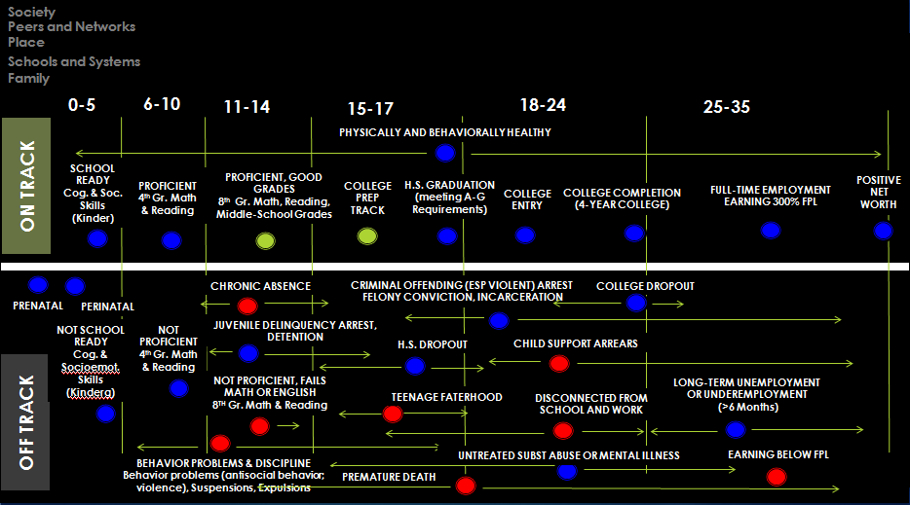
Generationally
Linked Life Courses:
Adopt a Two-Generation Approach
Father’s Life Course (or Mother’s)
While these are later life course interventions, they have early life course implications for the next generation.
Roughly 65% of black and Latino fathers have their first child before age 25. By age 30, roughly 85% of these fathers have had their first child. These fathers have 2 or fewer kids on average around 5 years apart. Thus, by age 35, a majority of the next generation has been born. [Martinez et al, 2012]
Child’s Life
Course

Slide 28
Early Childhood Intervention

Slide 29
What does the evidence say about what works in Pre-K?
The Current State of Scientific Knowledge on Pre-Kindergarten Effects (April, 2017) offers a consensus statement by leading early childhood researchers published by Brookings and the Duke Center for Family and Child Policy
Top 10 Findings:
The evidence on the effectiveness of pre-K for improving math and reading skills is strong and consistent
The evidence on effectiveness of pre-K for improving socioemotional skills is neither strong nor consistent
Most studies of pre-k effects do not follow students for very long. Those that do, find that pre-k effects fade out between the beginning of kindergarten and the end of 3rd grade

Slide 30
What does the evidence say about what works in Pre-K?
Top 10 Findings Cont…
Math and literacy focused curricula are much more effective at improving math and reading skills than are whole-child curricula (e.g. The Creative Curriculum, High Scope, Montessori). In fact, school- or center-developed curricula are often as effective as these popular whole-child curricula.
The strongest curricula for enhancing socioemotional skills is Preschool Paths [HEAD START REDI]
The deployment of curricula that are successful at improving cognitive skills have two key ingredients:
Intensive professional development for teachers with coaching at least twice a month
Assessments of child progress to inform and individualize instruction

Slide 31
What does the evidence say about what works in Pre-K?
Key Findings cont…
Low-income and Latino children benefit disproportionately from pre-k programs
Teacher education, years of experience and staff-child ratios are weak predictors of effective pre-k programming. This raises important questions about what should be the educational requirements for early childhood education workforce.
Group size and classrooms tailored to young children with bathrooms and eating areas included in the room are associated with greater effectiveness of pre-k programming
Process factors like curriculum, teacher language complexity, student engagement through activities, and positive classroom climate are strong predictors of pre-k programming effectiveness. These are also hard to standardize and regulate from a policy standpoint.

Slide 32
Do the Effects of Early Interventions Vary by Gender?
Abecedarian, Perry Preschool and Early Training Project
Programs benefited boys and girls in middle childhood, where outcomes measured during teen and adult years showed moderate effect sizes for females, but negligible impacts for males (Anderson, 2008)
Chicago Child-Parent Centers:
Program had stronger long-term effects on the educational outcomes of boys compared to girls. Boys who attended CPC had 20 percentage-point higher levels of high school completion as well as more years of completed schooling than boys in the comparison group. Girls did not show such impacts. (Ou and Reynolds, 2010)
Head Start:
In the long run, boys showed higher achievement test scores and educational attainment, lower rates of grade retention and crime and better health than girls (Deming, 2009)
Tulsa Pre-K Program
Impacts on math persisted through third grade for boys, not for girls. Reading did not differ by gender (Hill, Gormley and Adelstein, 2015)
Boston Pre-K Program
No gender differences (Weiland and Yoshikawa)

Slide 33
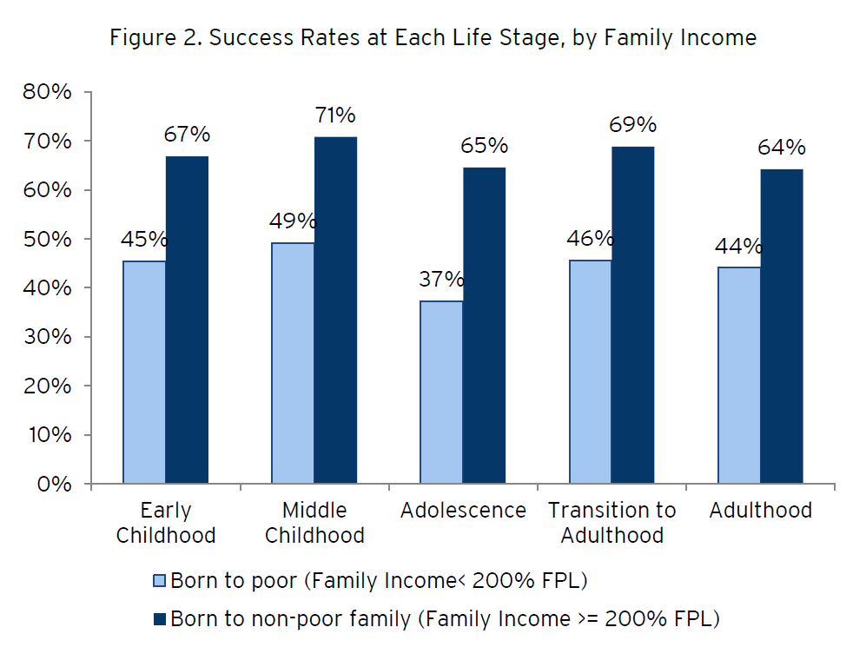
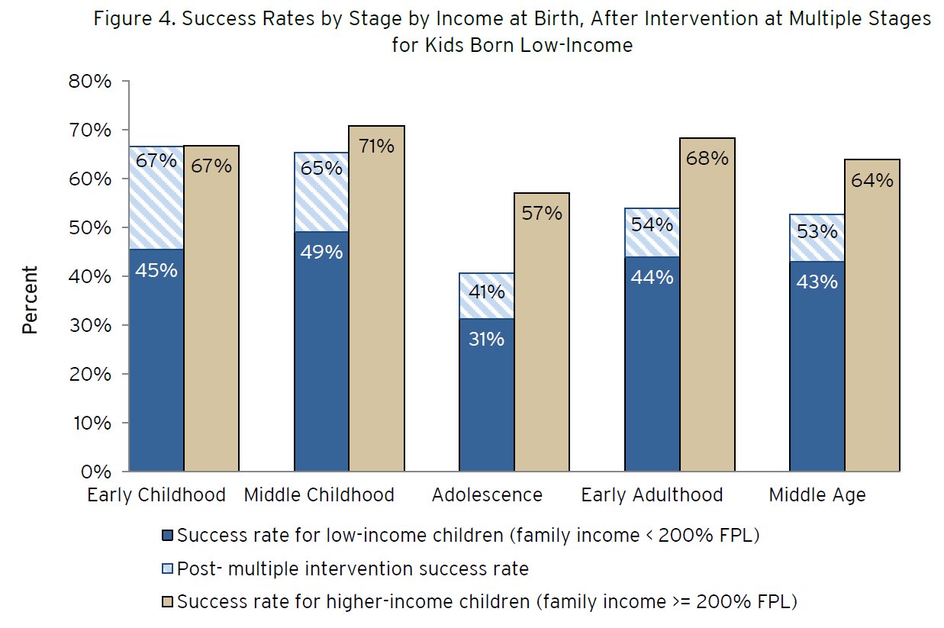
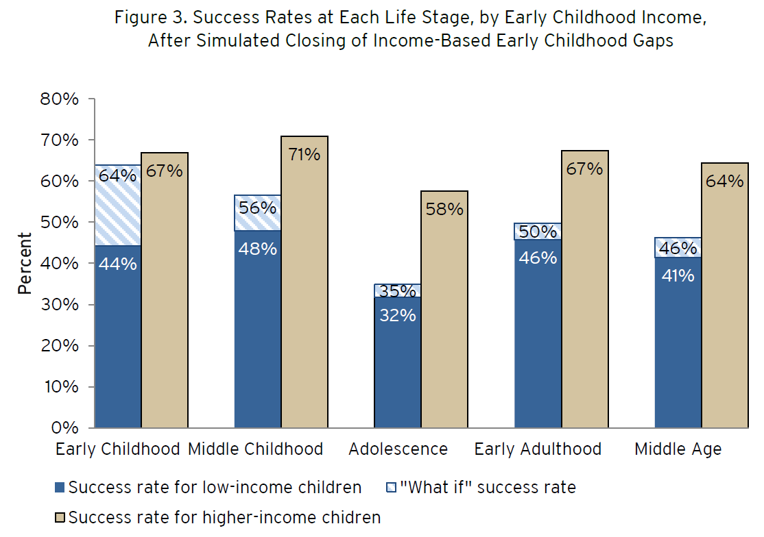
What is the potential long-term yield of improving early childhood outcomes?
We need boosters or charging stations in adolescence and early adulthood
The Social Genome Project can help us answer this question
Fadeout
What would happen to later life outcomes if we equalized early childhood outcomes?
The simulated effects of evidence-based interventions during these age spans

Slide 34
Family
Schools & Childcare
Place
Peers, Mentors & Networks
Institutions & Public Systems
--Parental SES
--Race/Ethnicity
--Parent age at birth
--Child Maltreatment
--Family Structure
--Family Instability
--Parental Incarceration
--ACEs
--Child insurance cover
--Housing Disadvantage
--Parental Caregiving
--Parent Expectation, Attention and Skills
--Food Security
--Blended Family
--Parent Documentation
--Childcare avail + quality
--Pre-K avail + quality
--Teacher Quality + turnover
--Peer Effects
--School Discipline
--School Climate
--Classroom Management
--Curriculum & Pedagogy
--Class Size
--Racial Segregation
--Income Segregation
--Seg. of Poverty
--Seg. of Affluence
--Income Inequality
--Concentrated Poverty
--Concentrated Disadv
--Median Fam Income
--Violent Crime & Homicide
--Concentrated Incarc
--Residential Instability
--Physical Disorder
--% Foreign Born
--Collective Efficacy
--% Owner-Occ Housing
--Adult Educ Attainment
--Antisoc, Delinquent Peers
--Relation with Caring Adult
--Positive Mentor Relation
--Friends School Attachment
--Mean GPA of friends
--Same Age, Younger, Older Friends
--% friends 1st or 2nd gen immig
--Juvenile Justice System
--Criminal Justice System
--Neighborhood and Community Institutions
--Social, Health and Human Service Systems
--Affordable Housing System
--Workforce Dev System
0-5
6-11
12-18
19-25
26-35
SCHOOL READY
Cog. & Soc. Skills (Kinder)
PROFICIENT 4th Gr. Math, Reading, & Socioemo. Skills
PROFICIENT, GOOD GRADES
8th Gr. Math, English, Middle-School Grades
H.S. GRADUATION
(COLLEGE & CAREER READY)
POSTSECOND. CREDENTIAL
COLLEGE COMPLETION
(4-year college)
STABLE HOUSING
STABLE FULL-TIME EMPLOYMENT @ 300% FPL
COLLEGE
ENROLLMENT
STABLE FULL-TIME EMPLOYMENT
ON TRACK
SECURE
ATTACHMENT
Early Childhood Interventions
Pre-K
Child First
Head Start REDI
Career Academies
Becoming a Man
Success for All
H&R Block FAFSA Experiment
College Possible
Bottom Line
Jobstart
Youthbuild
Year Up
Attachment and Biobehavioral Catchup (ABC)
First Year Experience Courses
Nurse-Family Partnership
Healthy Families America
Check & Connect
Career Academies
Becoming a Man
Multisystemic Therapy
Quantum Opportunities Program
INSECURE
ATTACHMENT
CHRONIC ABSENCE
OFF TRACK
NOT PROFICIENT
4th Gr. Math, Reading, & Socioemo Skills
CRIMINAL OFFENDING (ESP VIOLENT) ARREST, FELONY CONVICTION, INCARCERATION, RECIDIVISM
PRE-TERM BIRTH/LOW BIRTHWEIGHT
JUVENILE DELINQUENCY (ESP VIOLENT), ARREST, DETENTION, RECIDIVISM
HOUSING INSTABIITY OR HOMELESSNESS
CHILD SUPPORT ARREARS
NOT PROFICIENT, FAILS MATH OR ENGLISH
8TH Gr. Math & English
TEENAGE PARENTHOOD
DISCONNECTED FROM SCHOOL AND WORK
COLLEGE DROPOUT
NOT SCHOOL READY
Cog. & Soc. Skills (Kinder)
H.S. DROPOUT
EARNING BELOW 300% FPL
LONG-TERM UNEMPLOYMENT OR UNDEREMPLOYMENT
(>6 Months)
INFANT
MORTALITY
BEHAVIOR PROBLEMS & DISCIPLINE
Behavior problems (antisocial behavior; violence), Suspensions, Expulsions
PBIS
Restorative Justice
NO PRE-K

Slide 35
www.forwardchangeconsulting.com

Slide 36
Citations
Anna Aizer and Joseph J. Doyle Jr. (2013) “Juvenile Incarceration, Human Capital and Future Crime: Evidence from Randomly-Assigned Judges.” Working Paper 19102, National Bureau of Economic Research. Available online at http://www.nber.org/papers/w19102.
M. Anderson (2008) “Multiple Inference and Gender Differences in Effects of Early Intervention: A Reevaluation of the Abecedarian, Perry Preschool and Early Training Projects.” Journal of the American Statistical Association, 103(484), 1481-1495
Margery Austin-Turner et al (2014) Tackling Persistent Poverty in Distressed Urban Neighborhoods History, Principles, and Strategies for Philanthropic Investment. Urban Institute
David Autor, David Figlio, Krzysztof Karbownik, Jeffrey Roth, Melanie Wasserman (2015) Family Disadvantage and the Gender Gap in Behavioral and Educational Outcomes, Working Paper 15-16 , Institute for Policy Research, Northwestern University
David Autor and Melanie Wasserman (2012) Wayward Sons: The Emerging Gender Gap in Labor Markets and Education, The Third Way. Available at http://www.thirdway.org/publications/662
Sandy Baum, Jennifer Ma and Kathleen Payea (2013) Education Pays 2013: The Benefits of Higher Education for Individuals and Society. The College Board
Marianne Bertrand and Jessica Pan (2011), The Trouble with Boys: Social Influences and the Gender Gap in Disruptive Behavior, NBER Working Paper No. 17541, National Bureau of Economic Research. Available at: http://www.nber.org/papers/w17541
Claudia Buchman and Thomas A. DiPrete (2006) “The Growing Female Advantage in College Completion: The Role of Family Background and Academic Achievement,” American Sociological Review, 71 (4), pp. 515–541.

Slide 37
Citations
Centers for Disease Control (2010) "Homicide Rates Among Persons Ages 10–24 Years, by Race/Ethnicity and Sex, United States". Available at http://www.cdc.gov/violenceprevention/youthviolence/stats_at-a_glance/hr_age-race.html
Andrew J. Cherlin (2014) Labor’s Love Lost: The Rise and Fall of the Working Class Family in America. Russell Sage Foundation
Susan Clampet-Lundquist et al (2011) “Moving Teenagers out of High Risk Neighborhoods: How Girls Fare Better than Boys” American Journal of Sociology, Volume 116 Number 4 (January 2011): 1154–89
Todd Clear (2007) Imprisoning Communities: How Mass Incarceration Makes Disadvantaged Neighborhoods Worse. NY: Oxford University Press.
Deborah A. Cobb-Clark (2011) “Fathers and Youth’s Delinquent Behavior,” Working Paper 17507, National Bureau of Economic Research. Available at: http://www.nber.org/papers/w17507.
David J. Deming (2009) “Early childhood intervention and life-cycle skill development: evidence from Head Start.” American Journal: Applied Economics, 1(3), 111-134.
David J. Deming (2014) “School Choice, School Quality, and Postsecondary Attainment”. American Economic Review. 104(3): 991–1013
Michael Greenstone and Adam Looney (2012) “The Impact of Economic and Technological Change on Marriage Rates”, The Hamilton Project.
Candace Hamilton Hester, Chris Meyer, and Steven Raphael (2012) “The Evolution of Gender Employment Rate Differentials within Racial Groups in the United States”, The Journal of Legal Studies, Vol. 41, No. 2 (June 2012), pp. 385-418 http://www.jstor.org/stable/10.1086/667578.

Slide 38
Citations
Carolyn J.Hill, William T. Gormley, Jr, .Shirley Adelstein (2015) “Do the short-term effects of a high-quality preschool program persist?” Early Childhood Research Quarterly, 32, 60-79
Brian A. Jacob (2002) “Where the Boys Aren’t: Non-cognitive Skills, Returns to School and the Gender Gap in Higher Education” Economics of Education Review, 21: 589–598.
Brian L. Jacob and Tamara Linkow Wilder (2011) “Educational Expectations and Attainment,” in Greg J Duncan and Richard J Murnane, eds., Whither Opportunity, Russell Sage Foundation, pp. 133–162.
Guyonne Kalb and Jennny Williams (2003) "Gender and Delinquency", Applied Economics Letters, 2003, 10, 425–429
Rose M. Kreider and Renee Ellis (2011) “Living Arrangements of Children: 2009," Current Population Reports, P70-126. Washington, DC: U.S. Census Bureau.
John M. Leventhal, Julie R. Gaither and Robert Sege (2014) "Hospitalizations Due to Firearm Injuries in Children and Adolescents", Pediatrics; originally published online January 27, 2014: Available at http://pediatrics.aappublications.org/content/early/2014/01/22/peds.2013-1809
Gladys Martinez, Kimberly Daniels, and Anjani Chandra (2012), Fertility of Men and Women Aged 15–44 Years in the United States: National Survey of Family Growth, 2006–2010, National Health Statistics Report
Douglas S. Massey (2007) Categorically Unequal: The American Stratification System. Russell Sage Foundation
Richard J. Murnane (2013) U.S High School Graduation Rates: Patterns and Explanations, NBER Working Paper No. 18701. Available at: http://www.nber.org/papers/w18701

Slide 39
Citations
Suh-Ruu Ou and Arthur J. Reynolds (2010) “Mechanisms of effects of an early intervention program on educational attainment: a gender subgroup analysis”. Children and Youth Services Review, 32, 1064-1076
Derek Neal and Armin Rick (2014) The Prison Boom and the Lack of Black Progress after Smith and Welch, NBER Working Paper No. 20283. Available at: http://www.nber.org/papers/w20283
Pew Center on the States (2010) Prison Count 2010: State Population Declines for the First Time in 38 Years. Available online at: http://www.pewtrusts.org/~/media/legacy/uploadedfiles/wwwpewtrustsorg/reports/sentencing_and_corrections/PrisonCount2010pdf.pdf
John Pfaff (2011) The Causes of Growth in Prison Admissions and Population Available at SSRN: http://ssrn.com/abstract=1884674 or http://dx.doi.org/10.2139/ssrn.1884674
Steven Raphael (2007) “Early Incarceration Spells and the Transition to Adulthood,” in Danziger, Sheldon and Cecilia Elena Rouse (eds) The Price of Independence: The Economics of Early Adulthood, Russell Sage Foundation: New York pp. 278-306.
Sarah K. S. Shannon et al (2017) “The Growth, Scope, and Spatial Distribution of People With Felony Records in the United States, 1948–2010” Demography (2017) 54:1795–1818
Jeremy Travis and Bruce Western (2014) Growth of incarceration in the United States: The Growth of Incarceration in the United States: Exploring Causes and Consequences. National Academies Press. Available at: http://www.nap.edu/catalog.php?record_id=18613
Jonathan Vespa, Jamie M. Lewis, and Rose M. Kreider (2013) America’s Families and Living Arrangements: 2012 Population Characteristics. U.S. Census Bureau
Sara Wakefield and Christopher Wildeman (2013) Children of the Prison Boom: Mass Incarceration and the Future of American Inequality. Oxford University Press

Slide 40
Citations
Christina Weiland and Hirokazu Yoshikawa (2013) “Impacts of a prekindergarten program on children’s mathematics, language, literacy, executive function and emotional skills.” Child Development, 84(6), 2112-1314
Bruce Western & Becky Pettit (2010) "Incarceration & social inequality", Daedalus, Summer 2010
William Julius Wilson (1996) When Work Disappears: The World of the New Urban Poor. Knopf Doubleday
John Winters and Barry T. Hirsch (2013) “An Anatomy of Racial and Ethnic Trends in Male Earnings.” Review of Income and Wealth. Available online at: http://onlinelibrary.wiley.com/doi/10.1111/roiw.12064/abstract
Justin Wolfers, David Leonhardt, Kevin Quealy (2015) “1.5 Million Missing Black Men” New York Times, April 20th, 2015. http://www.nytimes.com/interactive/2015/04/20/upshot/missing-black-men.html?emc=edit_th_20150421&nl=todaysheadlines&nlid=38700727&abt=0002&abg=1&_r=1

