Slide 1
Federal & State ECE Policy Updates
Bay Area Early Childhood Funders
January 24, 2024
Laurie Furstenfeld
Director of Legal Advocacy
Child Care Law Center
© 2024 Child Care Law Center

Slide 2
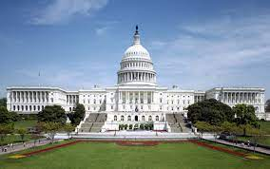
Federal & State Legislative Updates
2024-2025
Federal Budget
State Budget & Policy
What’s Ahead?

Slide 3
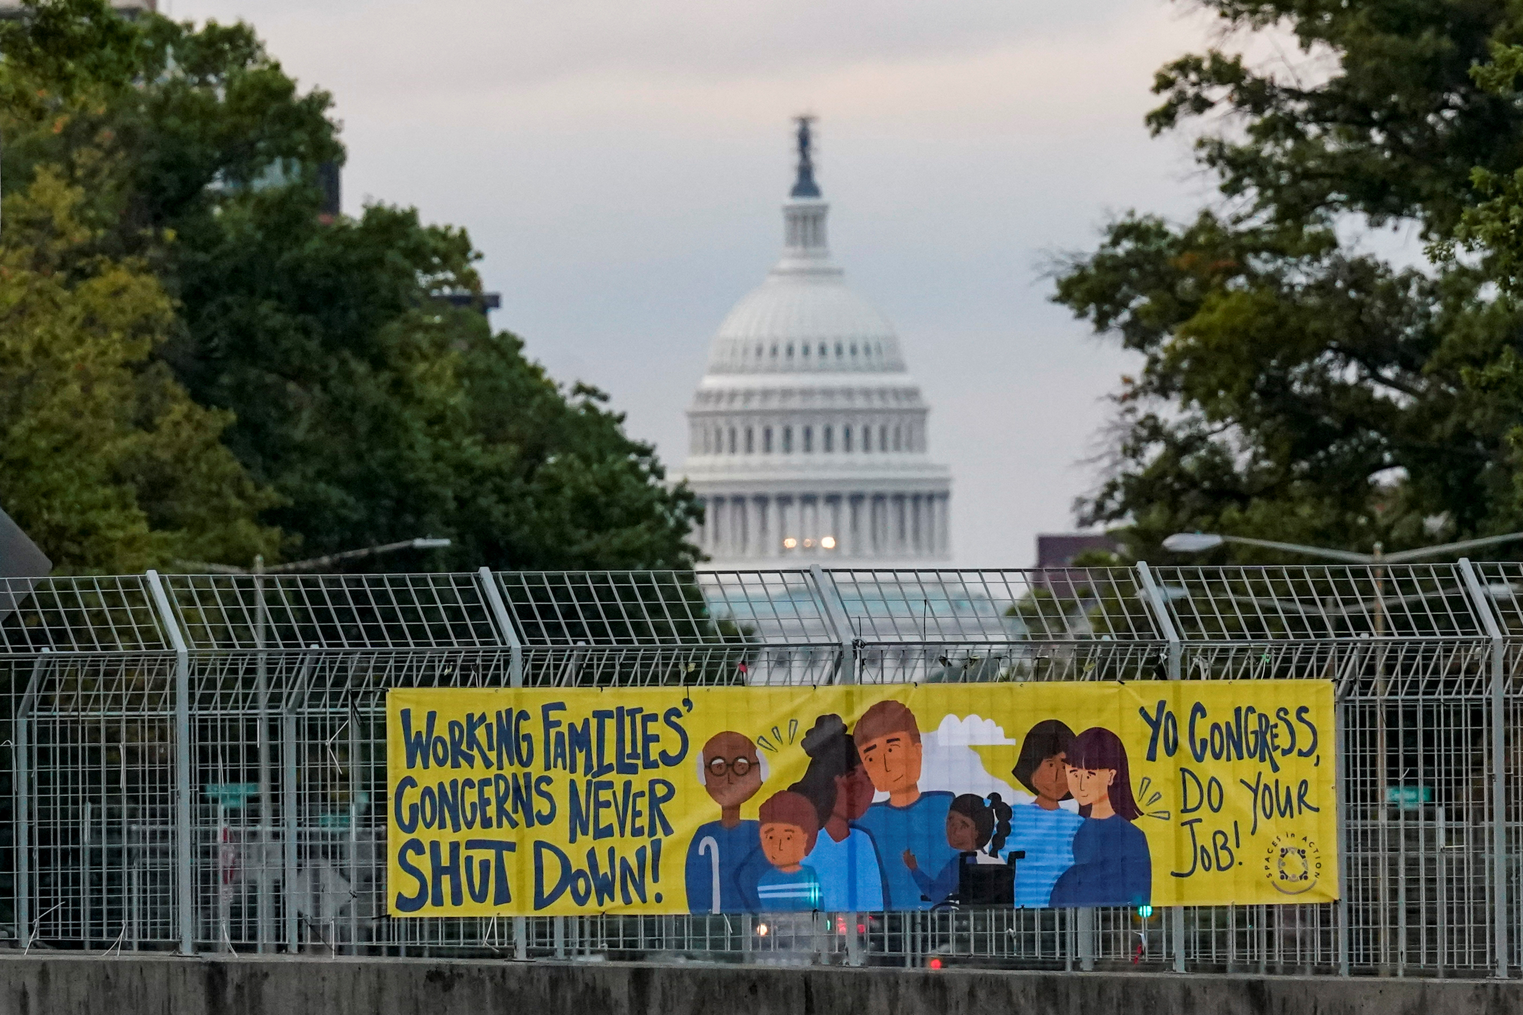
Federal Budget
FFY 2024
Congress and President Biden averted federal shutdown through early March.
$16 billion for child care not included.
Congress finalizing Child Tax Credit to lift estimated 400,000 children above poverty line.

Slide 4
California State Budget
FY 2024-2025
Governor Newsom announced his proposed budget on January 10, 2024.
$291.5 billion spending plan
Budget shortfall:
$37.9 billion (Governor)
$58 billion (Legislative Analyst’s Office)
Governor’s shortfall plan:
Draws down state reserves
Shifts around funds
Reduces & delays program funding

Slide 5
Child Care Programs
No new money to pay providers a fairer wage: Only references next steps for cost-based formula (“alternative methodology”).
No new child care spaces: For second year, delays Governor’s promise of new 200,000 spaces by FY 25-26. Officially pushes back deadline to FY 26-27.
No child care budget cuts: Current funding remains the same.

Slide 6
California State Preschool & Transitional Kindergarten
Maintains current funding for CSPP and expansion of TK.
Delays $550 million for California Preschool, Transitional Kindergarten and Full-Day Kindergarten Facilities Grant Program from this year to next year.

Slide 7
CalWORKs
Reductions in key CalWORKs Programs:
Family Stabilization (for families experiencing crisis, such as drug treatment and emergency housing)
Reverts $55 million GF from 2023-24 and reduces $71 million GF beginning 2024-25 and ongoing.
Expanded Subsidized Employment (assists CalWORKs participants with procuring jobs)
Reverts $134.1 million GF in 2023-24 and reduces $134.1 million GF in 2024-25 and ongoing.
Employment Services Intensive Case Management:
Reduces $47 million GF in 2024-25 and ongoing.

Slide 8
Other Vital Programs for Children and Families
Critical Supports for Immigrant Families:
Expands Medi-Cal Eligibility to income-eligible undocumented immigrants ages 26-49 starting January 1, 2024.
Maintains the grant increase for the Cash Assistance Program for Immigrants (equivalent to the SSI/SSP grant).
California Earned Income Tax Credit (CalEITC): No new funding and a $20 million reduction in tax outreach, education, and free tax preparation services from last year.

Slide 9
Other Vital Programs for Children and Families
Food Assistance for Families:
Extends California Food Assistance Program eligibility for undocumented individuals over age 55 starting October 2025.
Funds the CalFresh benefit pilot program.
Phases in the Summer EBT program for students eligible for reduced-price meals.
Fully funds the universal school meals program in 2024-25 ($122.2 million increase).
Maintains $1.8 million from previous allocations, but reverts $33.2 million from the California Nutrition Incentive Program, which gives monetary incentives to CalFresh, WIC, and Senior Farmers Market Nutrition Program participants when they purchase fresh produce.

Slide 10
New Policy Bill
AB 1808 (Nguyen): Extends 24-month eligibility to CalWORKs child care programs

Slide 11
Two-Year Policy Bills
AB 596 (Gómez Reyes) and SB 380 (Limón): Implement comprehensive rate reform; develop an alternative methodology based on the true cost of care.
AB 310 (Arambula): CalWORKs Reform.
AB 518 (Wicks): Expands Paid Family Leave for chosen family members.
AB 51 (Bonta): Mitigates impacts of TK for child care providers, expands navigation and referral services for early learning and care programs and TK, and requests the University of California to study the impacts of TK on the early child care and education ecosystem.
AB 679 (Wicks): Increases the reimbursement rate to 100% for meals served in a family child care home.
SB 9 (Cortese): Creates a three-year pilot program in at least three counties to extend foster care services to non-minor dependents up to 22 years old if they are experiencing or at reasonable risk of homelessness.

Slide 12
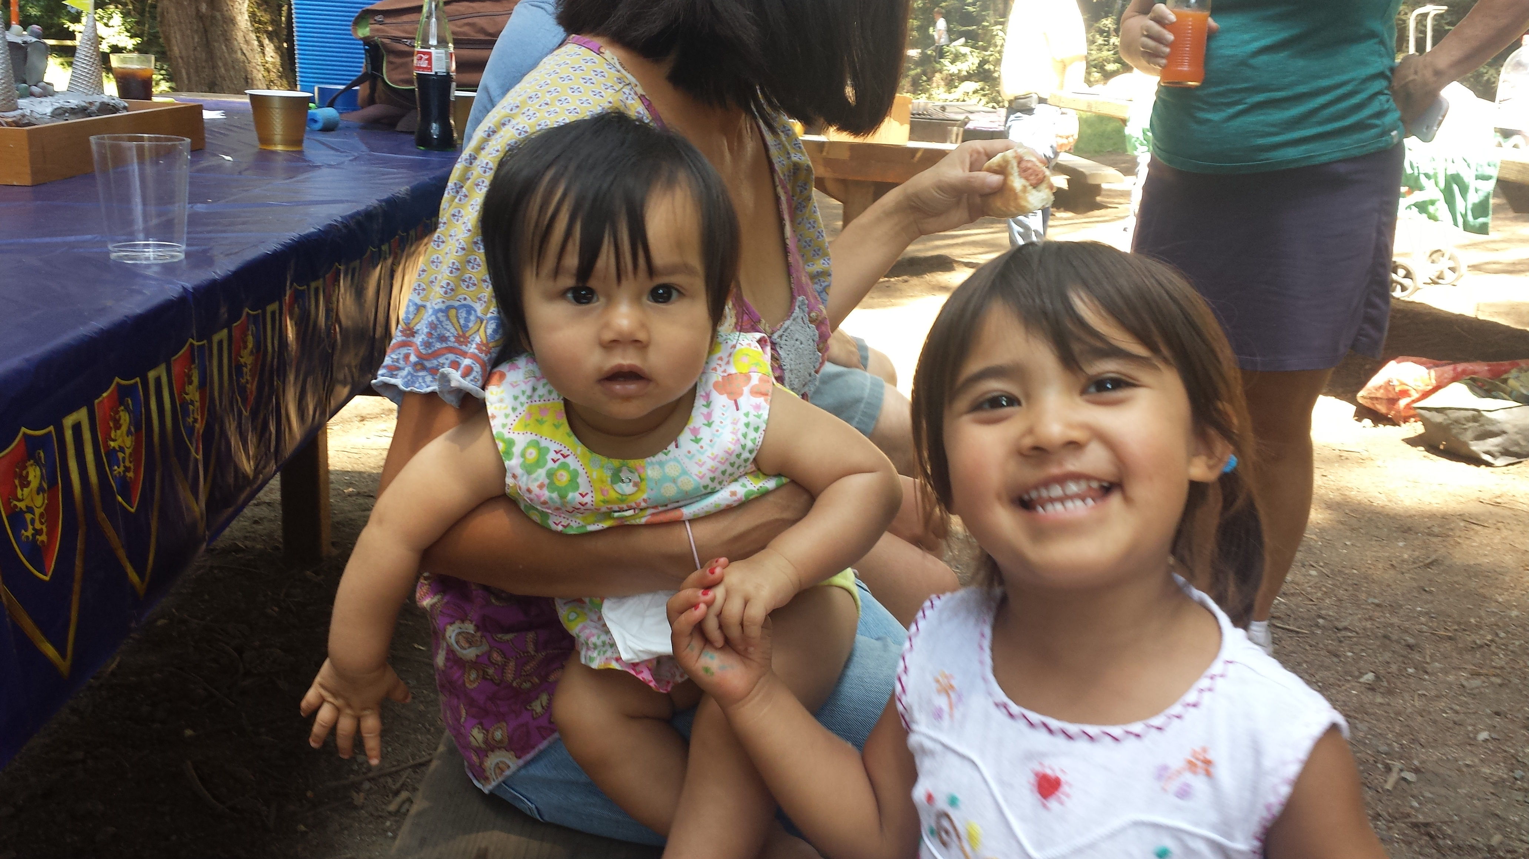
What’s Ahead?
ECE Coalition Priorities to Support Children, Families, and Child Care Providers
Rate reform – implement cost-based model
Increase child care spaces
Legislative Hearings
Budget Hearings through June
Policy Bill Hearings through August
Child Care and Development Fund
2025-2027 State Plan

