Slide 1
Federal & State ECE Policy Updates
Bay Area Early Childhood Funders
October 19, 2023
Laurie Furstenfeld
Child Care Law Center
© 2022 Child Care Law Center

Slide 2
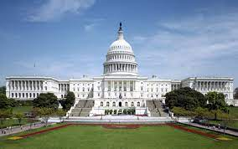
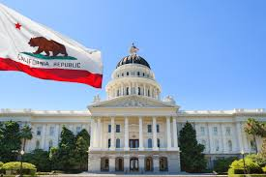
Federal & State Legislative Updates
2023-2024
Federal Budget & Policy
State Budget & Policy
What’s Ahead?

Slide 3
Federal Budget
FY 2023-2024
Federal shut-down temporarily averted through November 17, 2023
Child Care Stabilization Act - $16 billion for child care
Child Care Development Fund (CCDF) Notice of Proposed Rulemaking

Slide 4
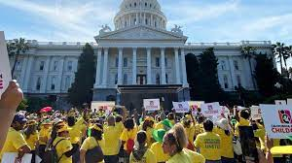
California State Budget
Child Care
FY 2023-2024
$6.9 billion ($4.1 billion General Fund) for child care programs, including $2.8 billion over two years to increase subsidy payments in all California child care and preschool programs.

Slide 5
Family Fees (child care fees)
Families do not pay a child care fee until they earn 75% of the State Median Income (SMI), ($73,380 for a family of 3)
Before: $288/month for a family earning $4,077 per month (50% of SMI)
Now: $0/month
Prior law required most families w/incomes above 40% pay family fees
Families pay no more than 1% of income when earning between 75% - 85% of SMI ($73,380-$83,167 for family of 3)
Before: $538/month for a family earning $73,380
Now: $61/per month
Prior law allowed for families to pay up to 10% of their income in family fees

Slide 6
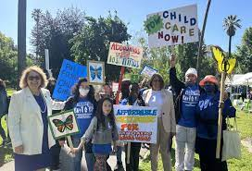
Family Fees (child care fees)
Uncollected family fees accrued before October 1, 2023 may be forgiven and not collected
Child care providers must be paid the full subsidy amount
Number of child care spaces must not be reduced because of the reduction in family fees
Notes:
Suggestion

Slide 7
California State Budget
State Child Care and Preschool Programs
Child Care Payment Rates
Supplements - one time and 2-year ongoing
Alternative Methodology
Pay based on enrollment rather than attendance
Full-time rate from 30 to 25 hours
Improved payment rate categories ensure providers are paid the maximum amount possible

Slide 8
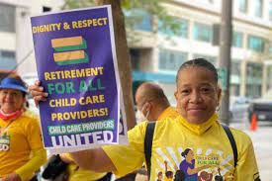
California State Budget
Health Care and Retirement for Family Child Care Providers

Slide 9
California State Budget
Department of Education (CDE) Early Education Programs
California State Preschool Program (CSPP)
Adds three-year-olds as a third priority for enrollment in part-day state preschool, if they are not enrolled in transitional kindergarten
Transitional Kindergarten
Expands TK enrollment to children who turn four years old between June 2 and September 1 during the preceding school year
Delays teacher credentialing and ratio requirements (from 1 adult to 12 children to 1 adult to 10 children) to 2025-2026
Expanded Learning Opportunities Program (ELOP)
Exempts ELOP programs from all Title 22 health and safety and state licensure requirements, i.e., no toileting and diapering assistance requirements, annual unannounced inspections, and publicly-posted health and safety site reports.

Slide 10
California State Budget
CalWORKs Grants
Increase maximum cash assistance payment beginning October 1, 2023 by 3.6%
Continue the 10% percent increase for the CalWORKs maximum cash assistance payments indefinitely

Slide 11
California Policy Bills
Improving the Lives of Women, Children, and Families
SB 616 (Gonzales) increases Paid Sick Leave from 3 days to 5 days.
SB 407 (Wiener) supports LGBTQ youth by requiring resource families to demonstrate their ability to meet the needs of a child, regardless of the child’s sexual orientation, gender identity, or gender expression.
SB 521 (Smallwood-Cuevas) adds denial of reasonable accommodations for pregnant or parenting students, in violation of Title IX, to the list of conditions that may be considered good cause for excuse from participation in welfare-to-work activities.

Slide 12
What’s Ahead?
Child care and early care advocates currently developing priorities for upcoming legislative year. Examples:
Funding to implement the Alternative Methodology and related needed policy changes
Funding to roll-out promised 200,000 child care
spaces by 2025
Expand “Universal Pre-Kindergarten”
to include family child care homes and
other community-based settings

