Slide 1
Trauma Informed Practices for Early Childhood
Enhancing Resiliency and Creating Trauma Sensitive Programs
Julie Nicholson, Ph.D.
Julie Kurtz, M.S., LMFT
Co-authors:
Nicholson, Perez and Kurtz: Trauma Informed Practices for Early Childhood Educators: Relationship-Based Approaches that Support Healing and Build Resilience in Young Children
Notes:
Main Points:
Keep slide up as individuals enter the training to start the day.
Script:
Welcome to Intermediate TIP-ECE training series. You have all met the requirement of attending a TIP 101 training. Now you have registered for a two-part series 102 and 103. Module 102 we learn about trauma and the impact and module 103 will be about practical strategies and developing an individualized behavior plan using an observation tool we will give you at the end of today. 103 will be XXX date and time as a friendly reminder.
Trainer introduces self and helps participants feel comfortable in the environment by sharing where bathrooms are located, is there breakfast, lunch and when breaks will be for the day. Please take breaks as you need to and stand or stretch at any time of the day for your comfort.
NOTE: INTROVERT AND EXTROVERT COMMENT regarding how folks learn and participate.

Slide 2
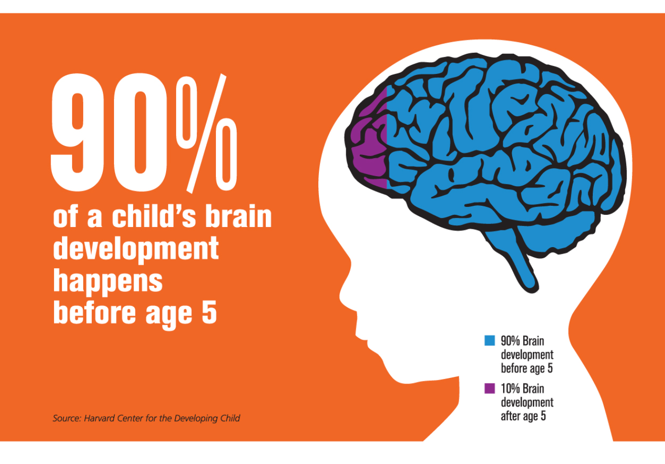
Why are the First 5 years critical?
“Early experiences affect how the brain develops, shaping how children learn, behave, and grow.”
- The Center for the Developing Child at Harvard University

Slide 3
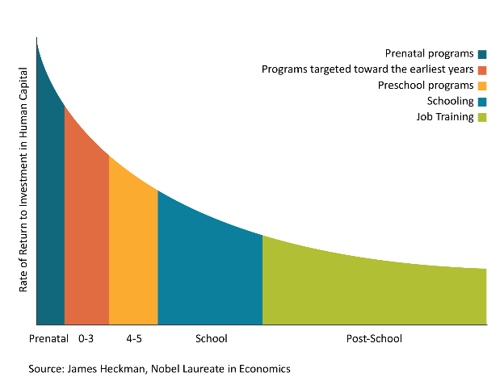
Funding Goes Furthest When We Invest in Our Youngest Kids
High quality birth-to-five programs for disadvantaged children can deliver a 13% return on investment

Slide 4
Voices from the field…
Some kids I just can’t seem to help
I feel helpless
I don’t even want to work with some of these kids
Behaviors are getting worse
I have tried everything
What is wrong with you!?
If the family got help then the child would be better
It is the families fault
I must not be a good educator if I can’t reach this child
They are spoiled
They are just trying to get attention
We need to move the child to another classroom
We should expel this child to keep the other children safe
Other? What have you heard?

Slide 5
Giving a Child a Voice
Moving from…
“What is wrong with you?”
to
“What has happened to you?”
to
“What is your behavior communicating?”

Slide 6
Sesame Street and the Today Show
Video: www.today.com/video/elmo-and-his-sesame-street-pals-want-to-help-kids-cope-with-trauma-1064263235627
Notes:
Main Points:
Add any relevant information
Script:
Sesame street has been one leader in getting the message out nationally around the impact of trauma in early childhood. They are promoting some key messages such as helping a child create a safe space and how important adult relationships are. Let’s watch the Today Show where they introduce this to the country. Trauma Informed Care in early childhood is not a movement and you are a part of that movement here and now.
www.today.com/video/elmo-and-his-sesame-street-pals-want-to-help-kids-cope-with-trauma-1064263235627

Slide 7
Why Is This Important?
Trauma is an actual or perceived danger that undermines a child’s sense of physical or emotional safety or poses a threat to the safety of the child’s parents or caregivers, overwhelms their coping ability, and impacts their functioning and development.
Nicholson, Perez and Kurtz: Trauma Informed Practices for Early Childhood Educators: Relationship-Based Approaches that Support Healing and Build Resilience in Young Children
Notes:
Main points:
We are often the first responders in a child’s life
Traumatic events for a child cannot be ignored
Sustained stress has numerous adverse effects
Young children are particularly vulnerable to the effects of exposure to trauma
It is easier to learn fear and harder to unlearn it
Our own sustained stress can impair our ability to develop loving empathic relationships with the children in our care
Script:
Traumatic events have a profound sensory impact on young children. Their sense of safety may be shattered by frightening visual stimuli, loud noises, violent movements, and other sensations associated with an unpredictable frightening event. The frightening images tend to recur in the form of nightmares, new fears, and actions or play that reenact the event. Lacking an accurate understanding of the relationship between cause and effect, young children believe that their thoughts, wishes, and fears have the power to become real and can make things happen. Young children are less able to anticipate danger or to know how to keep themselves safe, and so are particularly vulnerable to the effects of exposure to trauma.Reducing sustained stress is a win-win for us and those around us. Stress biases us toward selfishness, decreases accuracy when reading facial expressions, and adults exhibit more risk-taking behaviors. It impairs our ability to shift tasks and stay focused. It causes aroused focus and induces a ‘chicken with the head cut off’ affect. Stress also makes people implicitly look at angry faces or challenging behaviors more, as a way of constantly scanning for danger. (Adapted excerpts from the Book called BEHAVE by Robert Sapolsky) I am not sure what portion was adapted, or how this source works. I changed the wording around and removed a large portion that belongs elsewhere in the slides, but this might need a second look. JK- the slide does not come from the book. I just read this book and included in this script some comments that come from BEHAVE. When the trainer uses this script they can refer to the book BEHAVE
Trauma disrupts healthy development by interfering with a child’s capacity to develop positive relationships with adults and peers, to learn and play, and to self-regulate their emotions, attention, and behavior. Exposure to trauma is unfortunately a very common experience for our youngest children (Ghosh Ippen, Harris, Van Horn, & Lieberman, 2011). Research demonstrates that a majority of children in the United States have been exposed to trauma and the prevalence of trauma is highest for children in their early childhood years (Briggs-Gowan, Ford, Fraleigh, McCarthy, & Carter, 2010; Shahinfar, Fox, & Leavitt, 2000). In fact, childhood trauma has been named our nation’s single most important public health challenge (van der Kolk, 2014).

Slide 8
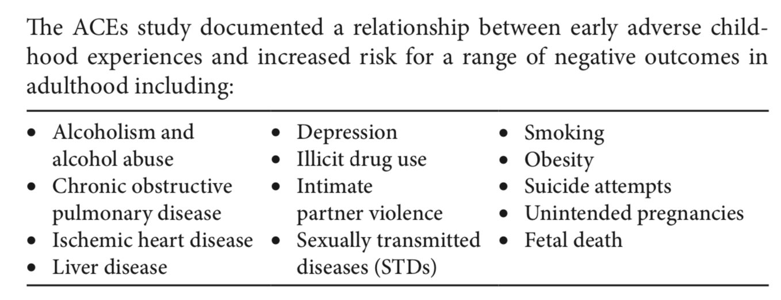
Adverse Childhood Experiences Study (ACES)
(www.cdc.gov/violenceprevention/acestudy/)
The Adverse Childhood Experiences (ACEs) study was a landmark research project that catapulted the discussion of trauma and trauma-informed practices into our national dialogue. The ACEs study was sponsored and conducted by Kaiser Permanente and the Center for Disease Control and Prevention from 1995 through 1997. The goal of the study was to investigate the impact trauma and stressful experiences during the childhood years have on adult health outcomes.

Slide 9
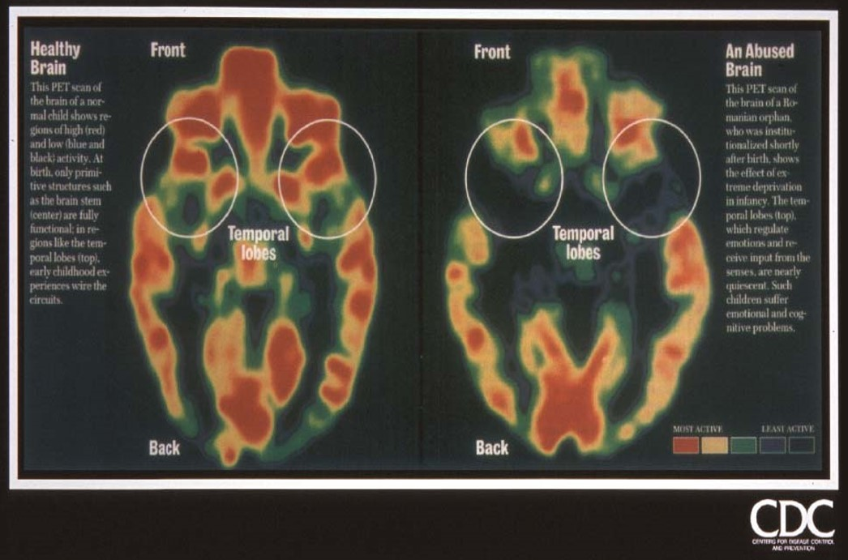
Impact of Trauma on Brain Development

Slide 10
Healing Organizations

Slide 11
Types of Systems of care
Trauma Dis-Organized
-Fight, flight or freeze
-Rigid
-Not feeling safe
-Overwhelmed
-Reactive
-Unpredictable
Trauma Informed
- Understands impact
-Looks at policy and procedure
- Implements some guiding principles
Trauma Healing Predictable and safe
-Reflective, not reactive
-Calm and regulating
-Self-care and wellness
-Creative
Notes:
Main Points: (Trauma Inducing, Trauma Reducing, Healing)
Goal: to transform our organizations from trauma-inducing to trauma-reducing and healing
Trauma sensitive and informed organizations
realize widespread impact of trauma,
recognize trauma’s effects and share common understanding and language about this,
respond to our trauma understanding by changing practices and policies to address trauma’s effects,
resist re-traumatization of people in the organization. We use or guiding principles to achieve this.
But not enough to be trauma-informed, ultimately want to be healing organizations
Integrated and collaborative with each other: Act with integrity/authenticity
Self-reflective: We pause, make meaning of, and learn from difficult experiences
Connected, take care of ourselves and each other
Celebrate successes, optimistic, and thrive in culture of wellness
Oriented towards learning and growth
Joy in creativity and innovation
Happy and grateful to come together to work and contribute towards the greater good

Slide 12
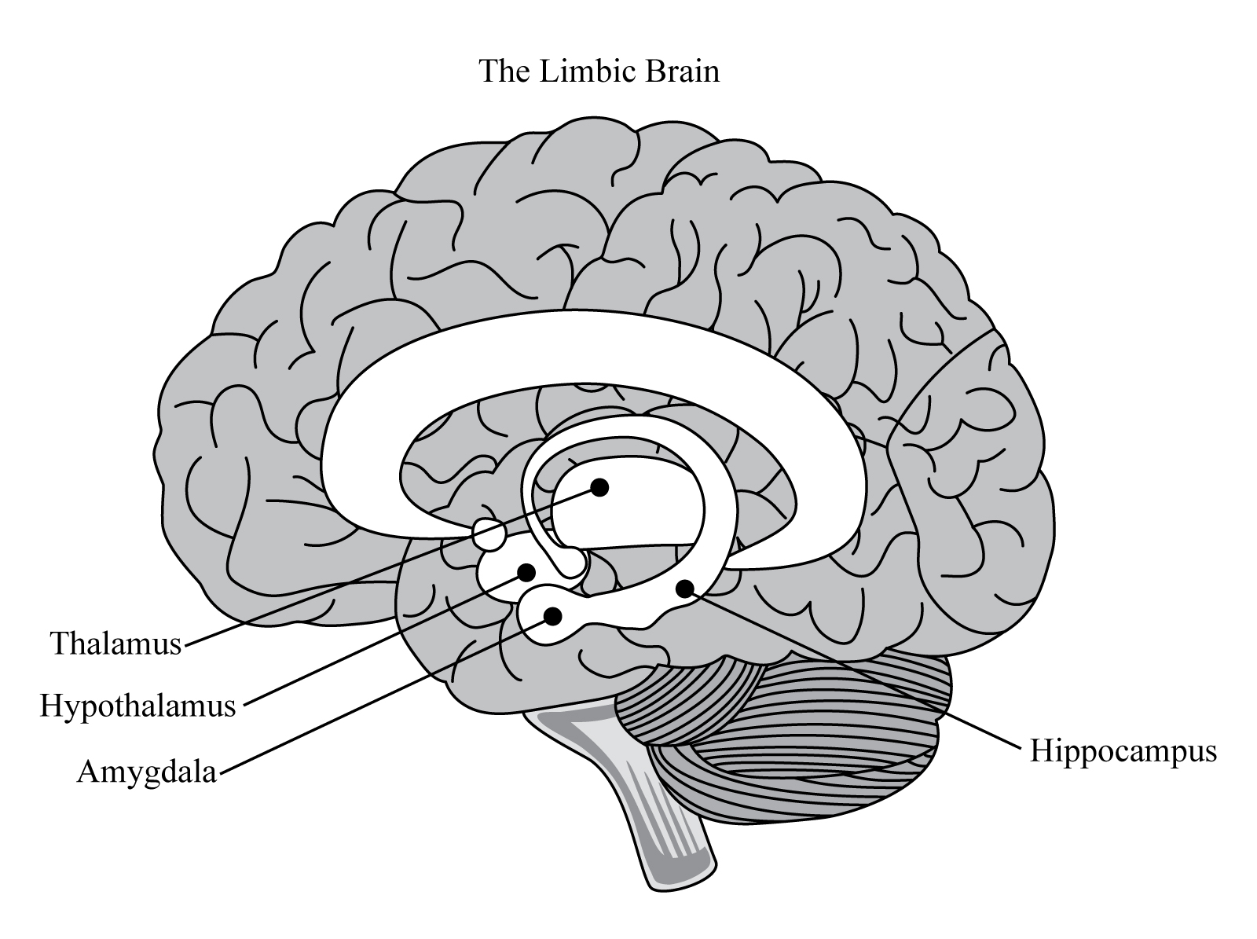
Brain Based Systems of care
Forebrain
“CEO”
“Air Traffic Control”
EXECUTIVE BRAIN
Abstract Thought
Reasoning
Impulse Control
Empathy
Perspective Taking
Logic
MAMMAL BRAIN
Attachment
Affect Regulation
Emotional Reactivity
Significance and Belonging
Emotions
Needs Connection
REPTILE BRAIN
Motor Regulation
Heart Rate
Breathing
Blood Pressure
Body Temperature
Sensory
Limbic
BRAIN
“Emotional Center”
“Attachment”
HINDBRAIN
“Alarm Center”
“Smoke Detector”
Brainstem
Photo: Courtney Vickery
Notes:
Describe the function of each part of the triune brain. They need to understand the behavior in each part and how the brain develops from the bottom up. Best book for new trainers is the Body Keeps Score by Bessel Van Der Kolk. I recommend reading this so you understand more about the brain parts.
Brain is Air Traffic Control System
The thinking lobes in the prefrontal cortex shut down when a brain is in pain.
When we feel distress, our brains and bodies prioritize survival, and we pay attention to the flood of emotional messages triggering the question, "Am I safe?" We react physiologically with an irritated limbic system that increases blood pressure, heart rate, and respiration with an excessive secretion of the neuro hormones cortisol and adrenaline pumping through our bodies. Chronic activation of the fear response can damage other parts of the brain responsible for cognition and learning.
Working memory: keeping information in mind long enough to initiate and complete tasks
Inhibitory control (impulse control): think before acting, filtering out distractions, delaying gratification, breaking habitual behaviors and regulating emotions
Cognitive or mental flexibility: shifting gears and scanning options for the optimal solutions
We have genetic blueprint, that is the nature, but how that blueprint is expressed and/or modified comes in the context of our relationships and environment: nurture
The trauma of abuse induces a cascade of effects, including changes in hormones and neurotransmitters that mediate development of vulnerable brain regions. Teicher, 2000
See Harvard Center for the Developing Child for more attached to the Executive Functioning Video. They usually give a handout or write up with each video.

Slide 13
A Culture of Healing and Restoration
“Trauma Informed Systems and healing practices support responsiveness in place of reaction (direction and correction or FIGHT),
curiosity in lieu of numbing (or FREEZE) and
opportunities for predictable meetings and reflection in lieu of avoidance (or FLIGHT).”

Slide 14
The 4 R’s of a Trauma-Informed System
Realizing the widespread impact of trauma and pathways to recovery
Responding by integrating knowledge about trauma into all facets of the system
Recognize the signs and symptoms of trauma.
Resisting re-traumatization of trauma-impacted individuals by decreasing the occurrence of unnecessary triggers and by implementing trauma-informed policies, procedures, and practices.
Substance Abuse and Mental Health Services Administration (2014). SAMHSA’S Concept of Trauma and Guidance for a Trauma-Informed Approach. SAMHSA’s Trauma and Justice Strategic Initiative.
Notes:
SAMHSA’s Elements of Trauma-Informed Care

Slide 15
Why Trauma is Not Addressed?
Lack of time
Uncomfortable
Lack of awareness
Lack of training
Misconceptions
Does not have necessary tools
OTHER?
Notes:
Pair share and report out what else they can think of under OTHER

Slide 16
Source-https://developingchild.harvard.edu/science/deep-dives/adult-capabilities/
Notes:
Sustained stress has numerous adverse effects. The amygdala becomes overactive and more coupled to pathways of habitual behavior; it is easier to learn fear and harder to unlearn it. We process emotionally salient info more rapidly and automatically, but with less accuracy. EF – working memory, impulse control, exec decision making, risk assessment, and focal attention is impaired, and the frontal cortex has less control over the amygdala. We then become less empathic and prosocial. Reducing sustained stress is a win-win for us and those stuck around us. Stress biases us toward selfishness. Stress decreases accuracy when reading facial expressions. Stress makes adults more risk taking. It impairs ability to shift tasks and stay focused. It causes aroused focus and induces a “chicken with the head cut off. Stress also makes people implicityly look more at angry faces or challenging behaviors. (adapted exerpts from the Book called BEHAVE by Robert Sapolsky.

Slide 17
Preventing burnout, compassion fatigue and secondary trauma
Burnout has to do with the stress and frustration caused by the workplace: poor pay, unrealistic demands, inadequate supervision etc.
Compassion Fatigue refers to the profound emotional, mental and physical adverse impact that takes place when helpers are unable to refuel and regenerate.

Slide 18
Thank You
Julie Nicholson
julie.m.Nicholson@gmail.com
Julie Kurtz
juliekurtzconsulting@gmail.com
Notes:
Remind of date of module, write it on flip chart.
Remind of observation report to complete.
Remind to bring all materials to next training including their safe space.

